Slide 1
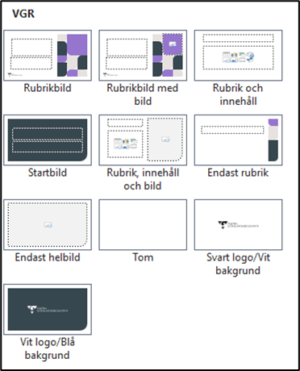
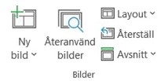
Instruktionssida
VGR:s grundmallar hjälper dig att göra rätt. De är säkrade ur tillgänglighetsperspektiv och följer vår visuella identitet, men det är alltid du som skapar en presentation som ansvarar för både form och innehåll.
I webbhandboken finns mer information om tillgänglighet: Dokument - Webbhandbok VGR (vgregion.se)
I lärportalen finns en utbildning om tillgänglighet i Powerpoint: Digital tillgänglighet (vgregion.se)
Ändra inte typsnitt och använd bara de godkända färgerna.
I VGR använder vi fyra grundmallar:
VGR:s bas (grå), som kan användas av alla
Hälso- och sjukvård (blå)
Kultur (röd)
Utbildning (grön)
Säkerställ att du använder rätt mall, kontakta din kommunikationsavdelning om du är osäker.
Alla grundmallar finns i Office-programmen, i mediebanken och på Sharepoint.
Layout kallas de olika designer på sidor som du kan hitta i din mall. Du hittar dem under knappen Layout och Ny bild i menyn.
När du vill byta design på en layout
Visar samtliga layoutsidor

Slide 2
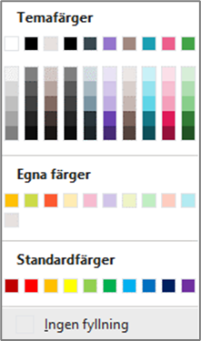
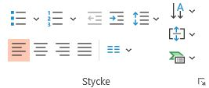
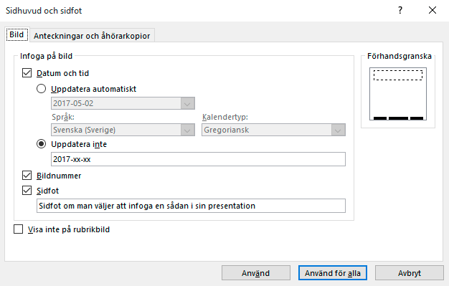
Instruktionssida
Använd rätt färger
De sex rutorna till höger är anpassade till diagram.
När du vill gå upp eller ned en nivå i en punktlista använder du Öka/Minska indrag.
De fyra första är färger för text och bakgrund
Används för dekorativa grafiska element
Undvik att skapa nya punktlistor i menyn.
Välj istället en layout som har en punktlista.
Använd inte Standardfärger.
Redigera sidfot och sidhuvud
Under fliken Infoga hittar du Sidhuvud och sidfot. När du klickar här öppnas en dialogruta med olika val du kan göra för att redigera sidfot och sidhuvud. Vill du att dina ändringar ska gälla för alla layouter väljer du Använd för alla. Vill du bara ändra på sidan du står på väljer du Använd.
Om du inte vill använda sidhuvud eller sidfot låter du fältet vara som det är.

Slide 3
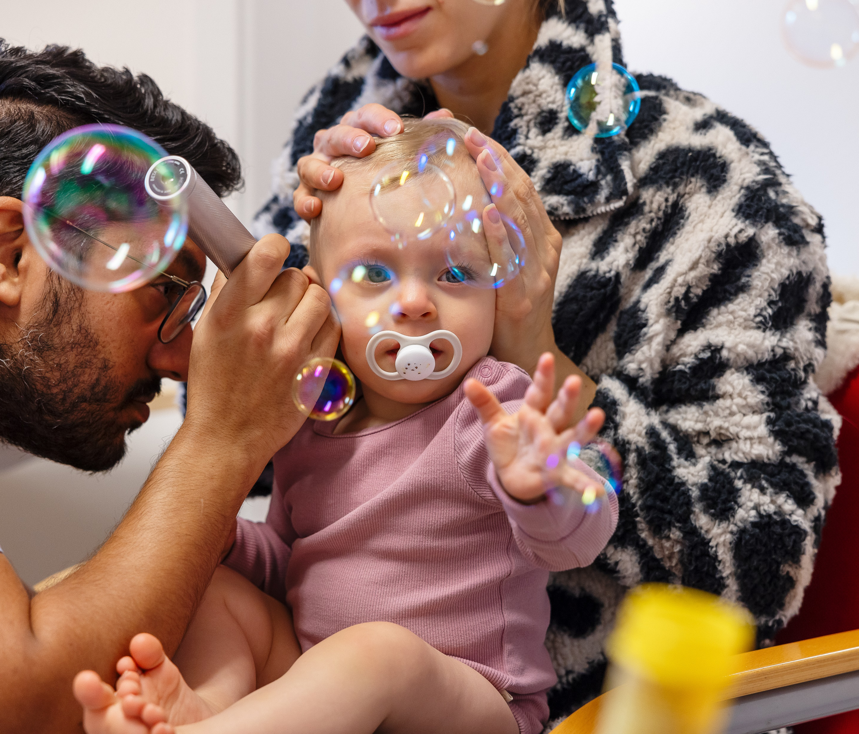
We are there for you in Västra Götaland
Notes:
Region Västra Götaland is there for you who live in Västra Götaland today.
Our 56,000 employees make us one of Sweden's largest public employers. Our mission is to contribute to a viable Västra Götaland and to the well-being of the 1.7 million people who live here.
The facts and financial figures in the presentation are from the 2025 financial statements and annual report.
(Budget on page 29 is the adopted budget for 2027)

Slide 4
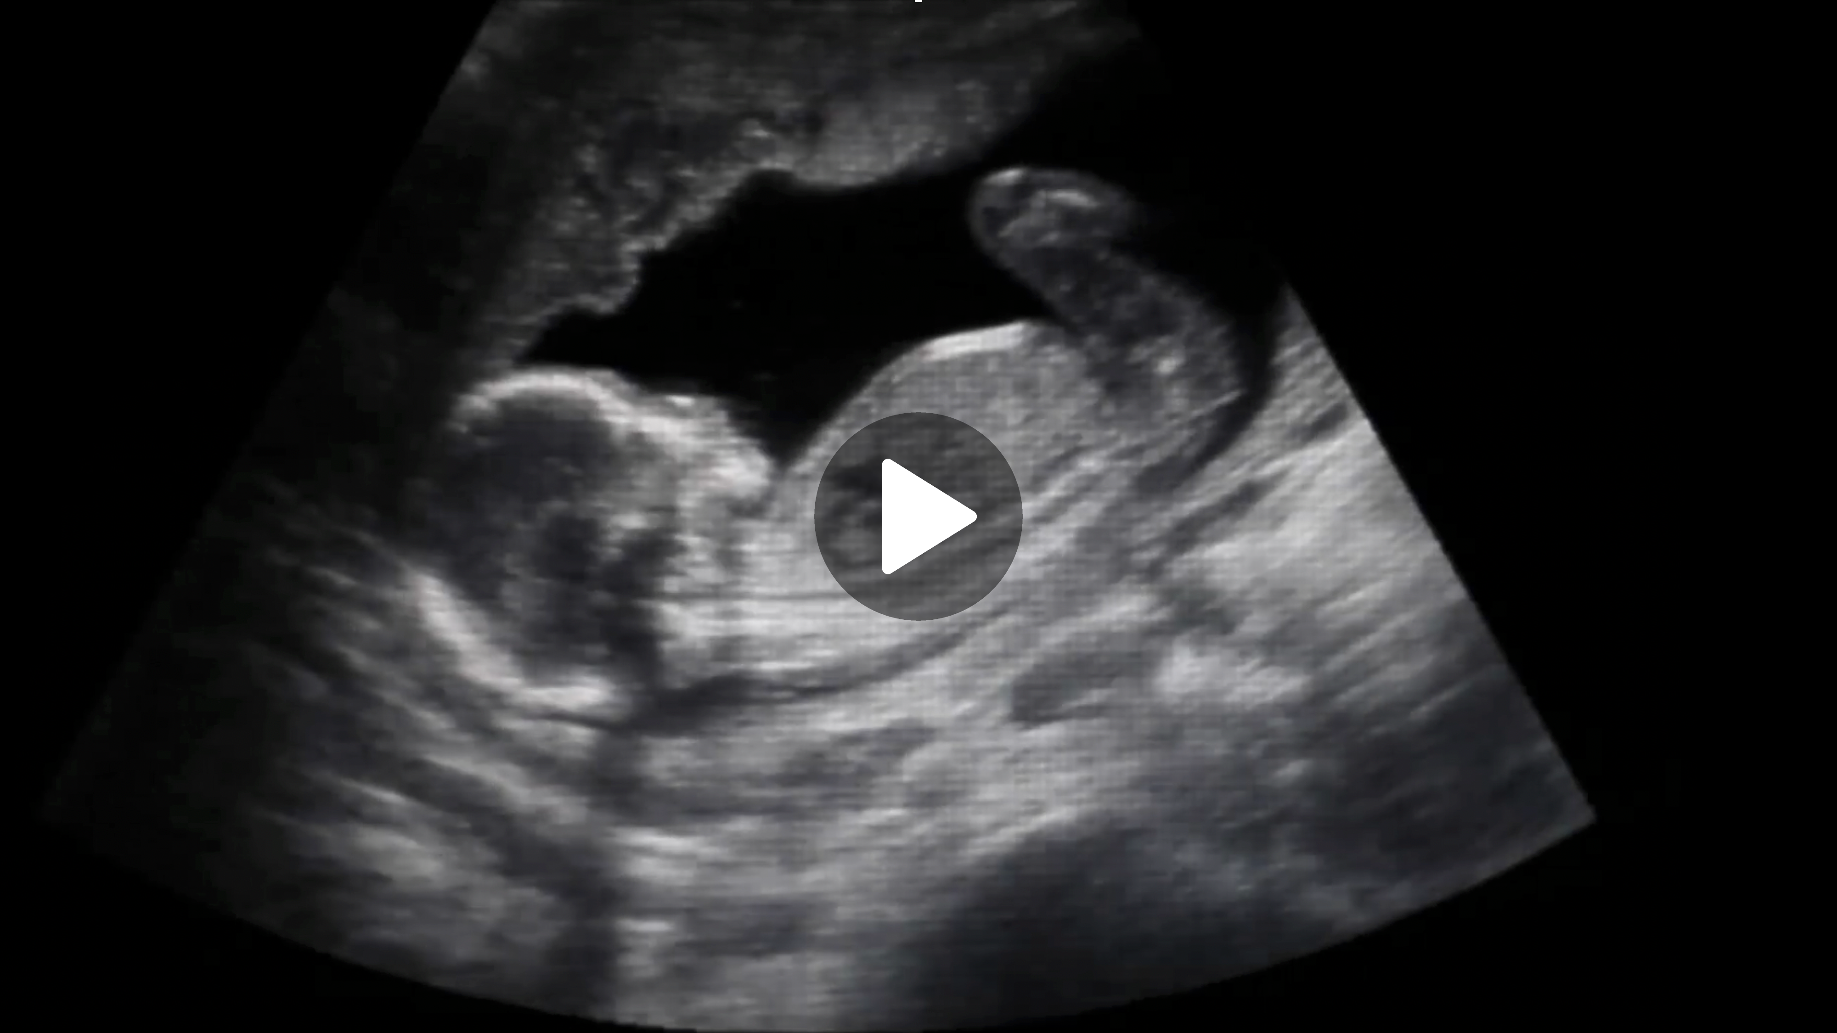
With you
throughout life
Notes:
Click to start presentation movie in presentation mode (2.08 min)
The movie opens in a browser.
Link: https://player.vgregion.se/s/jnvaBiSU2HMA6tW6C97cwV/74FKdommi98dZtRFyESVdN

Slide 5
When you need care, you should get the best. When you need to go somewhere, you should be able to use public transport. When you want to experience culture, it should be close to you. When you study, it should be on your own terms. And when you live in Västra Götaland, sustainable development should go without saying.
Notes:
Let the image stay in the background when you introduce yourself.
We are close to you. And we have a big responsibility. When you need care, you should get the best. When you're going somewhere, you can choose sustainable ways to travel. When you want take part of culture, it should be close to you. When you study, it should be on your own terms and in your interest. And when you live in Västra Götaland, sustainable development should go without saying.

Slide 6
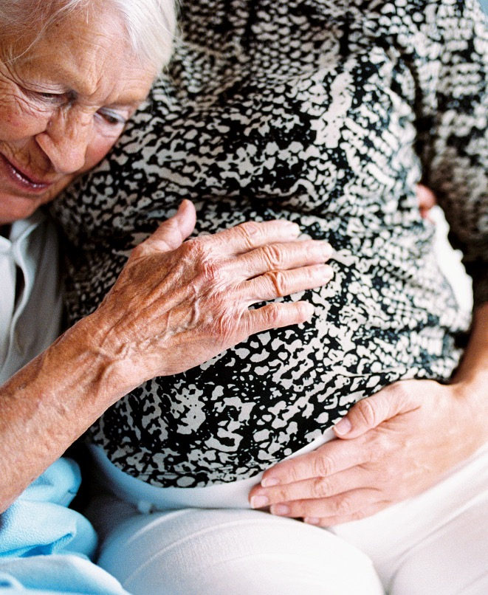
When you need care, you should get the best

Slide 7
When you need care, you should get the best
On weekdays
On weekends and evenings
Over 230 health centers and
child health centers
300 rehab clinics
17 out-of-hours service centers
1 local emergency clinic
4 emergency dental clinics
In case of major care needs
Contact on your terms
19 hospitals, including
1 university hospital
Digital care meetings with audio, video and chat
If you have complex needs
Oral health throughout life
In your home with mobile homecare
149 public dental care clinics
Notes:
We work closely with you to ensure that you have access to health and medical care.
On weekdays you can go to our health centers
On weekends and evenings you can get care at our out-of-hours service centers
Hospitals are available when you have major health needs.
You can get a good start in life with the help of our child health centers
Our public dentistry can help you keep your mouth and teeth healthy
and you can get back to everyday life with the help of the physiotherapists and occupational therapists at our rehabilitation clinics.

Slide 8
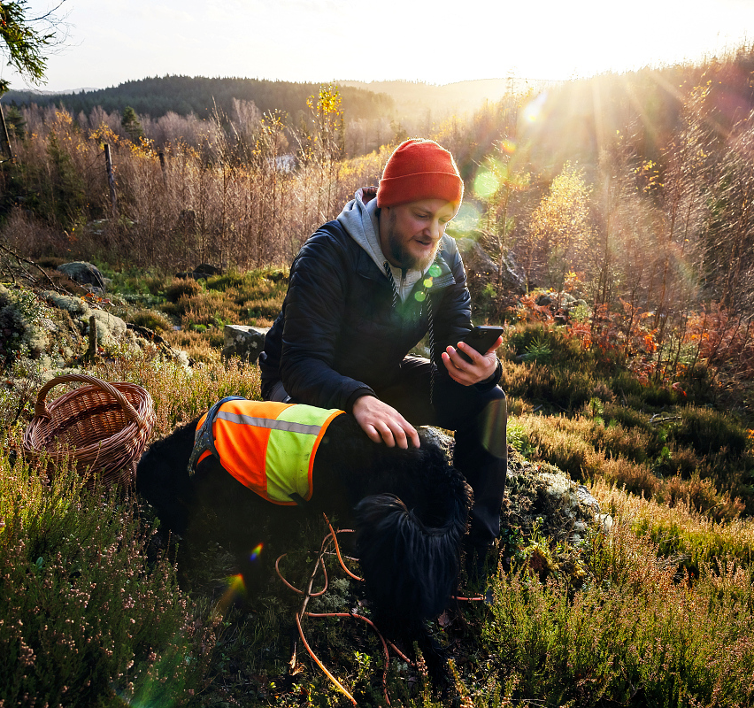
We develop healthcare
Priority is given to health care that provides the greatest benefits based on needs and resources
A special focus on children and youth
Digital when possible, in-person when needed
Preventive and health-promotive
Coordinated health care through shared information
Notes:
The overall goal of the healthcare service in Region Västra Götaland is to offer healthcare that is based on the needs and expectations of the residents in terms of accessibility, coordination and continuity.
Healthcare services need to use their skills and resources to do what's best for their citizens, and to get the most value from the resources available. Region Västra Götaland works to ensure that healthcare is coordinated across organizational boundaries (e.g. municipality/region) based on individual needs.
There is an ongoing collective effort to get closer to the citizen:
From emergency care to health promotion.
From hospital to primary care and/or home care.
From physical to digital – when possible.
New e-services offer greater opportunities to connect with healthcare from home. For example, through digital meetings with audio and video, text messages or chat. Some patient groups also have the possibility to measure their values from home, which can be monitored and acted upon by healthcare services if needed. It increases the possibility of being involved, avoiding certain physical visits to healthcare providers and increases safety when the healthcare provider can see current values early on and detect when something needs to be addressed.
For questions about future health information systems: Region Västra Götaland needs a new health information system because the current healthcare system is outdated and needs to be replaced. This work is ongoing.

Slide 9
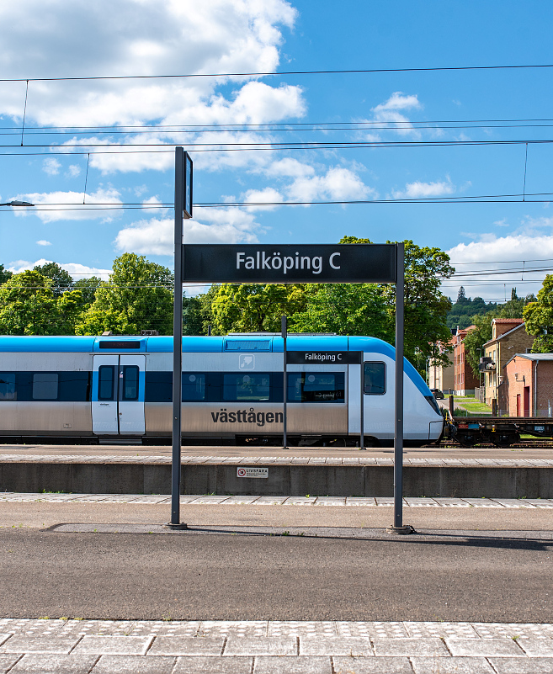
When you need to go somewhere, you should be able to use public transport
Notes:
For Västra Götaland to remain vibrant, public transport needs to work.
Our operational work in public transport is mainly carried out by our company Västtrafik.

Slide 10




When you need to go somewhere, you should be able to use public transport
For commuting and longer trips
Public transport in rural areas and the archipelago
Trains and buses connect the region
To get around in cities
Tickets on your phone
Trams, buses and ferries
90,000 tickets sold daily
Notes:
Through Västtrafik, we make sure you can commute to work or school, go on outings or visit friends. That you can get from A to B by a suitable mode of transport.
We have buses, trams, ferries and trains.
And local transport, Närtrafik, if you live in the countryside
A full city bus is equivalent to a 300-metre car queue, a tram to a 700-metre car queue and a commuter train to a three-kilometer car queue. So when we work more with public transport means that there will be less traffic in the city.

Slide 11
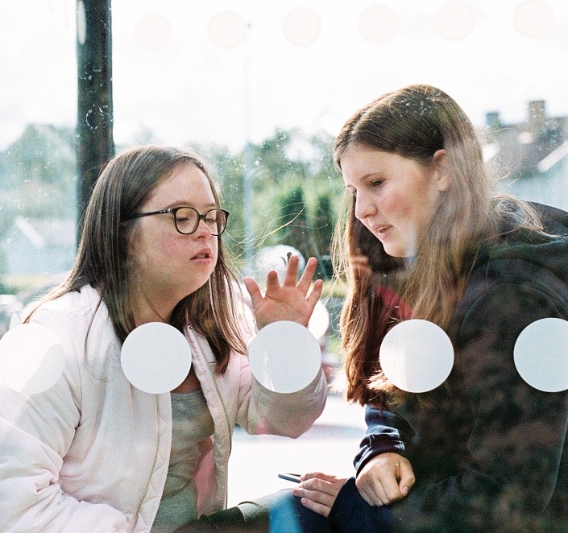
Sustainable travel for all – for everyone, everywhere
Linking Västra Götaland
Getting more people to travel by public transport
Accessibility for all
Better options to combine modes of transport
More sustainable solutions
Electric public transport throughout the county
Notes:
We are developing public transport to ensure that you can choose sustainable modes of transport as West Sweden grows and the population increases.
Right now we are focusing our work on
linking Västra Götaland by means such as extended railways (Gothenburg–Borås, to Landvetter)
encouraging more people to choose public transport, for example by upgrading and expanding regional railways and making it easier to travel
making public transport more accessible regardless of disability
Improving opportunities for combining modes of transport, such as taking your bicycle with you on public transport
Developing public transport to be even more environmentally friendly and sustainable by using electric buses and biogas, etc.

Slide 12
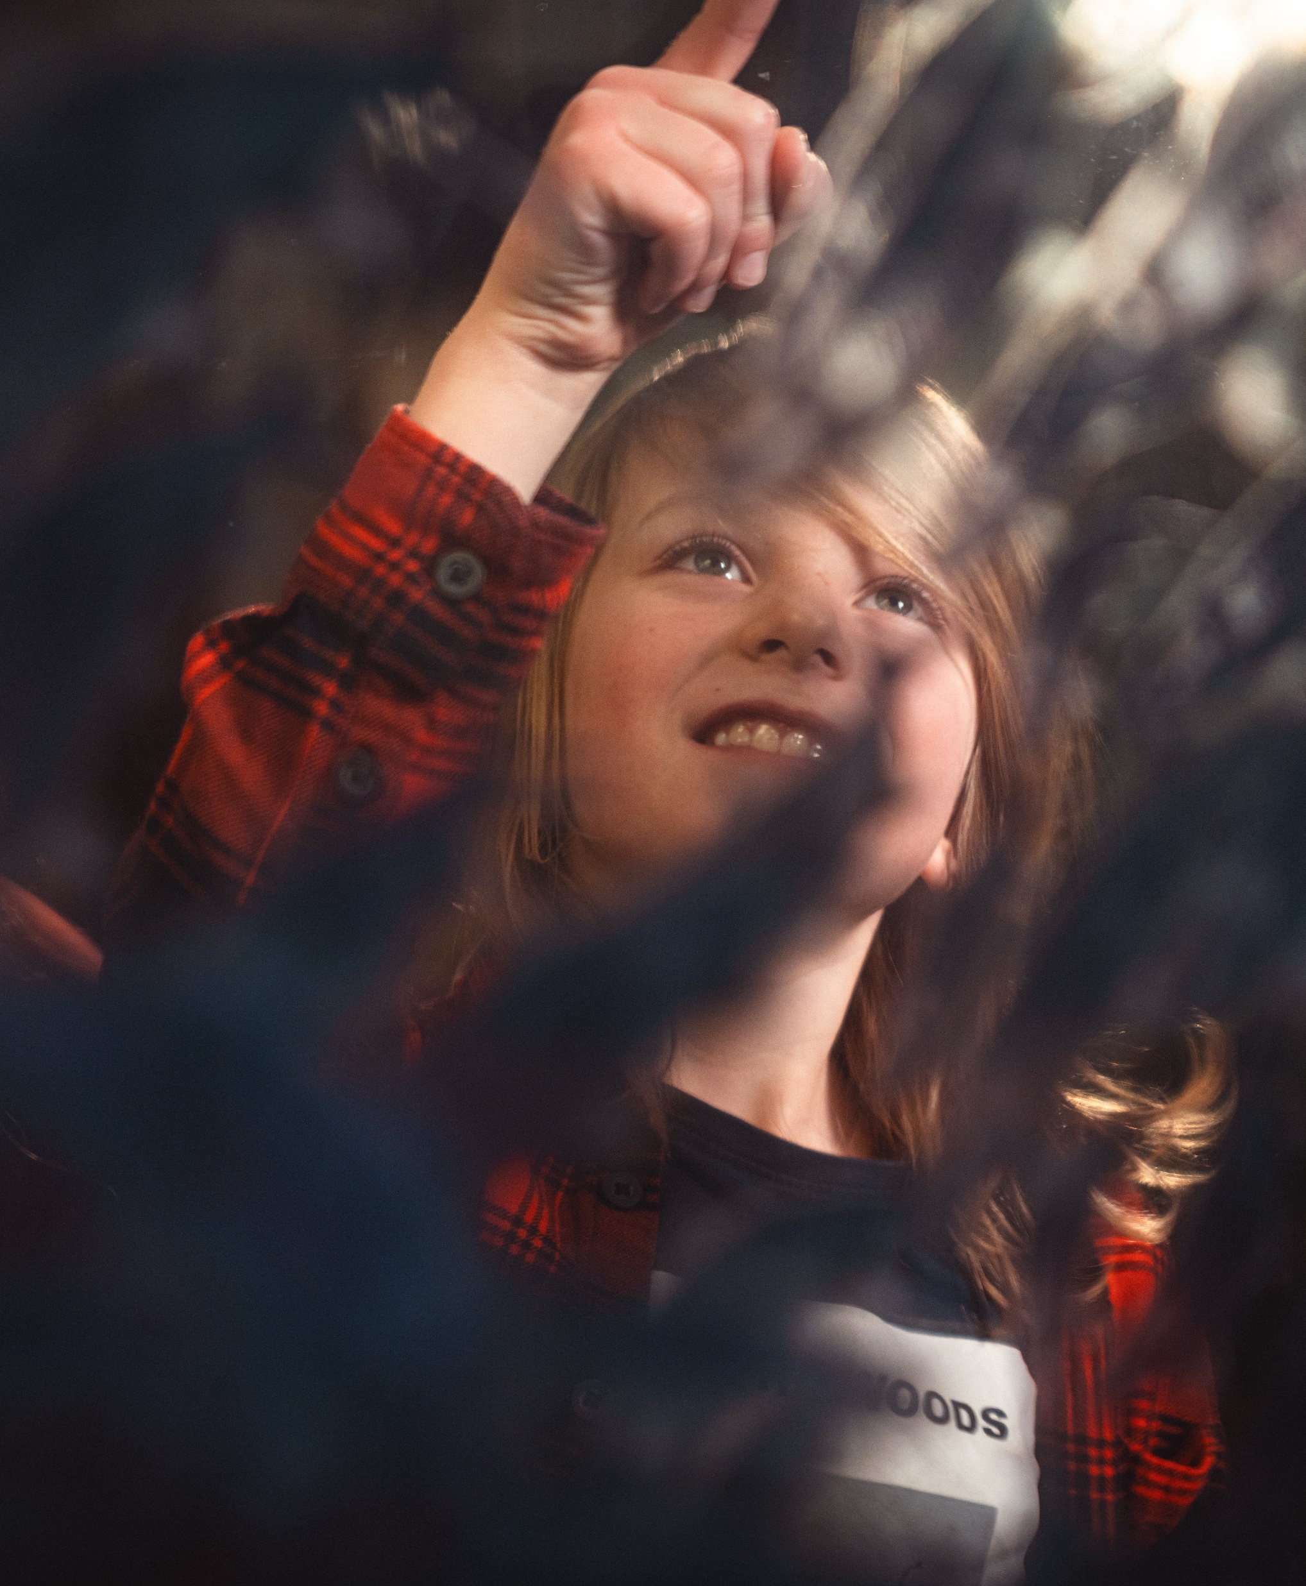
When you want to experience culture, it should be close to you
Notes:
Another part for both spirit and well-being is culture. We work to ensure that culture is accessible in the region, especially for children and young people.
VGR works A free, rich and strong cultural life throughout Västra Götaland. Read more at vgregion.se/kulturforvaltningen

Slide 13
When you want to experience culture, it should be close to you
As a newborn
As a visitor/spectator
Book as a gift for all newborns
The Gothenburg Opera
The Gothenburg Symphony Orchestra Film i Väst
Building conservation at Nääs
VGR's six museums
Gothenburg Botanical Garden
At school and in your free time
Regionteater Väst
Kulturkatalogen Väst
Gothenburg Museum of Natural History
Lödöse Museum
Vitlycke museum
Vänersborg Museum
Forsviks bruk
The Medical History Museum
Barnensbibliotek.se
For a vibrant cultural life
Support and grants for cultural operators
Networking events and meeting places
Cooperation with all 49 municipalities
Notes:
We have activities where residents of all ages can experience all kinds of culture. Children and young people can experience the performing arts through Regionteater Väst. Kulturkatalogen Väst has about 800 bookable events that VGR supports with 25 SEK per child. Managed by the Culture Department.
Cultural operators can apply for grants and scholarships, and participate in networks and development projects.
Experiencing culture is the foundation of a strong cultural life, and you can do that by going to events such as the Gothenburg Opera's performances or the Gothenburg Symphony Orchestra at the Gothenburg Concert Hall, both of which have touring activities to reach out around the region. If you see a Swedish film, our company Film i Väst has most likely co-produced it.
If you want to learn more about history, nature or crafts, you can visit our museums and attractions (Gothenburg Museum of Natural History, Lödöse Museum, Forsviks bruk, Building conservation at Nääs, Vitlycke Museum, and Vänersborg Museum).
You can even enjoy culture through your phone, for example digital museum exhibitions or GsO-play, where you can watch performances and concerts from the Gothenburg Symphony Orchestra online.

Slide 14
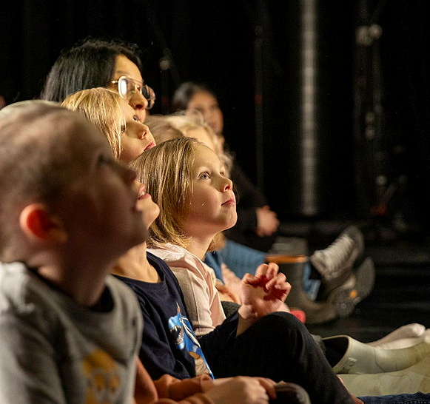
Culture is a natural part of everyday life
– how we stay close
By investing in culture, we create a vibrant cultural life for young people.
It is also a place where cultural
operators in the non-profit sector
can live, work and grow.
Notes:
Culture is a pillar of a democratic society. It not only fosters creativity, but also challenges our perceptions and creates new perspectives. Having access to culture is a human right and an important part of democracy.
Region Västra Götaland (VGR) is actively working to make culture accessible to all residents, regardless of where they live. With Sweden's strongest regional cultural budget, our plans and strategies are regularly developed in collaboration with municipalities, industry organizations, educational associations and the independent cultural sector. The goal is to have a wide and inclusive cultural life where children and young people in particular have the opportunity to both take part in and create culture themselves. The region is also investing in increasing media and information literacy in society, which is crucial for a functioning democracy.
The region's cultural institutions put Västra Götaland on the map. Regionteater Väst is Sweden's largest touring performing arts institution for children and young people and one of the country's largest producers of dance and theater performances for young audiences. The Gothenburg Opera's dance company and music activities has received international attention, and Film i Väst has contributed to international film productions. The Swedish National Orchestra tours both in the region and globally, further strengthening the region's cultural profile.
Photo: Camilla Lindberg, Scenkonstdagarna 2026

Slide 15
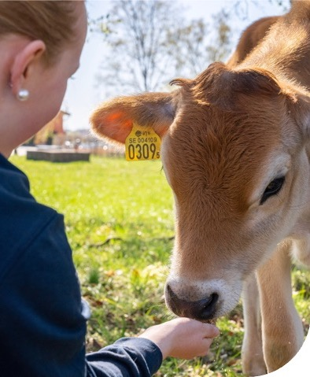
When you study, it should be on your own terms
Notes:
Education also plays a role for both health and spirit. We work to enable you to train on your own terms and secure skills in certain areas.

Slide 16
When you study, it should be on your own terms
Youth recreation leader
Animal husbandry
Crafts
Radio
+80
Natural resource management
education programs
Language
Health
Basic course
Marine biology
Music
Theater
Outdoor life
Meal attendant
Film production
Notes:
In total, we have over 80 courses across our different schools. In addition to the folk high schools, we also run agricultural high schools and adult education courses in the green industries.
We also have training initiatives to help those educated in other countries to enter the Swedish labor market, especially in the healthcare sector.

Slide 17
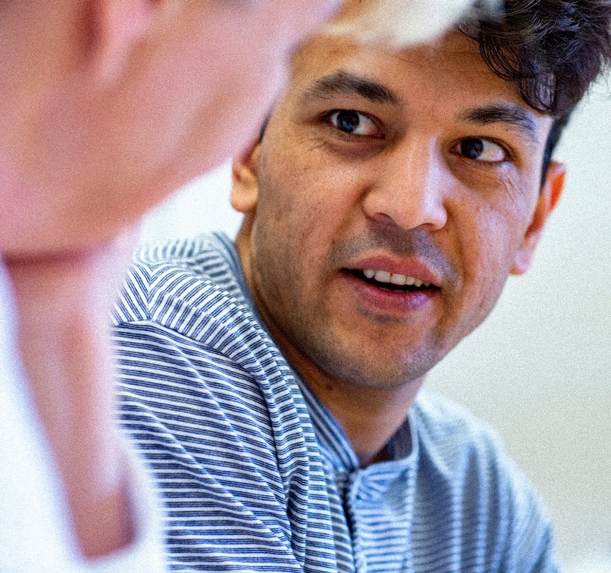
Education changes lives
Everyone should be able to graduate from primary school and high school with good grades
Supply of skills
We offer lifelong learning
Meeting places for research
We train the next generation of actors in Swedish food production
Notes:
Society calls for training that matches the skills needed today and tomorrow. People having good opportunities to educate themselves makes both the individual and society stronger. It also improves public health.
We work to create the best opportunities for education. Among other things:
we work together to ensure that all children and young people have access to education and subsequently good opportunities in life.
we work with Kraftsamling fullföljda studier, a joint effort to get more young people to graduate primary school with passing grades
we focus on the supply of skills to ensure a functioning labor market, where education leads to the right skills, where everyone's skills are used properly, and where our residents have the chance to continue their education and training into adulthood.
we work actively on lifelong learning to ensure that residents have opportunities to develop at all stages of their lives.
we fund business and research venues to meet the needs of the future.
– We also take responsibility for Sweden's future food supply by training the next generation of actors in domestic food production.

Slide 18

Living in Västra Götaland means that you have the opportunity to develop, work and live sustainably
Notes:
Living in Västra Götaland means that you have the opportunity to develop, work and live sustainably.

Slide 19
Living in Västra Götaland means that you have the opportunity to develop, work and live sustainably
Close innovation
In an equal society
Research, science parks, entrepreneurship
Inclusion, participation and human rights
Across the region
In everyday life
Infrastructure, rural development,
and the supply of skills
Sustainable transport, food security
and education
For more opportunities
Towards a greener future
Support, grants and partnerships
Biodiversity, climate, electrification, circularity
Notes:
What this means for you as a resident is that you can be certain that you are close to innovation, with research and science parks continuously looking for new solutions.
We are also working to ensure equal opportunities across the region – people should be able to live and earn a living in rural areas. Some issues such as spatial planning need to be examined at a regional level. The skills of all residents should be put to good use and matched with the labor market.
You should have opportunities to start your own business and be able to receive support and grants. For example, we provide support for young entrepreneurship, advice and financing. Grants for entrepreneurs with good ideas. Collaborations with different actors to foster good conditions for innovative business in the region.
In everyday life, sustainable transport and accessible destinations…
We work to ensure that you can live in an equal society through areas such as integration, accessible environments and human rights.
The environment is an area we work a lot with, for example with Biogas Väst, Climate 2030 and climate-smart holidays.

Slide 20

The world is changing – that's why we are developing the region to make society keep up with the changes
Taking the lead in the climate transition
Developing digital solutions, infrastructure and communications
Contributing to a viable, innovative and sustainable economy
Respecting human rights
Developing broadband and telecom networks in rural areas
Notes:
The world is changing. That's why we are developing the region to make society keep up with the changes.
Right now we are focusing particularly on
taking the lead in the climate transition, including getting more stakeholders to make solid commitments, encouraging more cycling, walking and public transport, and creating better conditions for using electric vehicles.
but also initiatives on sustainable fashion consumption and training on climate-smart food for grocery stores. We are part of the Climate 2030 coalition, which brings together companies, organizations, municipalities and others that want to take a stand and contribute to the transition to a climate-smart region. A climate-smart society provides competitive advantages, green jobs and it offers residents new ways to live a good life.
encouraging competitiveness, for example through working transport systems, but also by contributing to a viable and sustainable business community and by supporting research and innovative environments
human rights, e.g. with a focus on social sustainability, staff training on the Convention on the Rights of the Child and being the first to develop a regional human rights action plan. The plan contains twelve measurable objectives that we will aim to meet every year.
increasing broadband take-up and improving mobile coverage in rural areas as a way to connect the region and reduce urban-rural divides

Slide 21
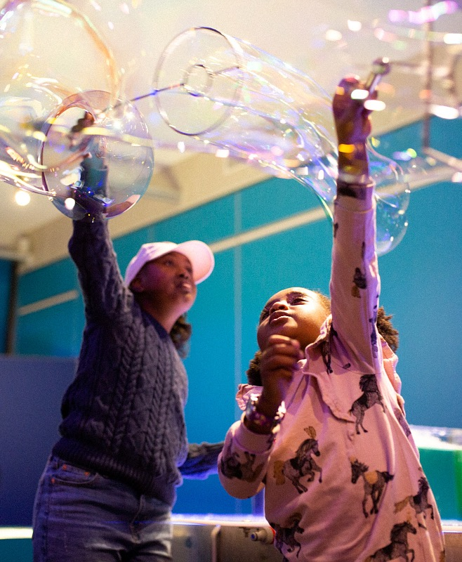
Big enough to act, close enough to understand
Notes:
The region is a political level between the municipality and the state. So what's so special about the regional level?
Yes, VGR is big enough to drive powerful change in society. Close enough to understand the needs of residents in Västra Götaland

Slide 22

Size + ambition =
POWER TO IMPLEMENT
Notes:
For one, we are a large organization with around 56,000 employees
We are responsible for a large geographical area. Västra Götaland consists of 49 municipalities with 1.7 million inhabitants and covers an area 300 kilometers long and 250 kilometers wide. It's a size that provides us with resources.
Combined with a high ambition to drive and lead the development of society means that Region Västra Götaland as an organization has a great potential to influence the world around us – both in the market and on other political levels.
One of our guidelines is that decisions should be taken as close to you as possible. It also means that development takes place as close to you as possible.
You should receive the best possible care. Our size and subsequently our resources create the conditions for this. Conditions that have not existed at the municipal level before, with the added bonus that we are close enough to be able to adapt on a local level.
You should be able to travel easily between municipalities. We plan the infrastructure and public transport so that it will work accordingly.
You should be able to live in a sustainable society. Our coordination and development potential make this possible at a level larger than the municipality, but closer than the state.
Among other things.

Slide 23
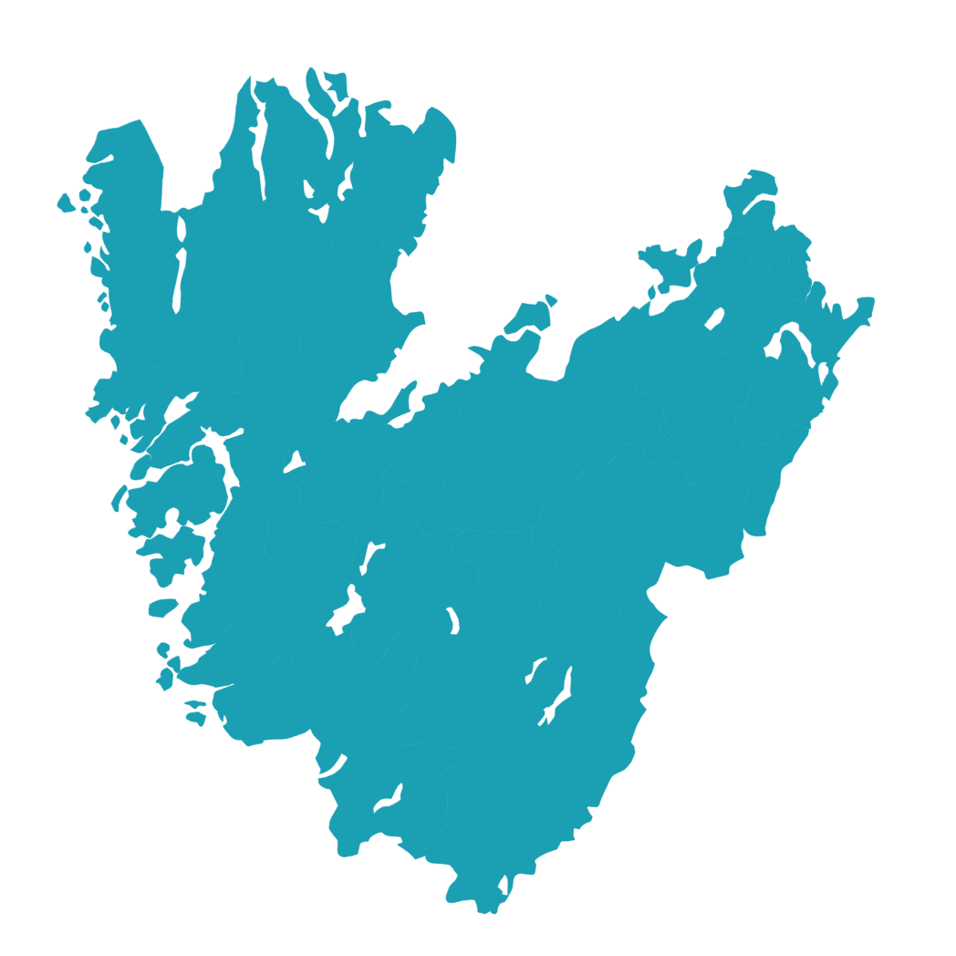




Everything is connected
Healthcare
Public
transport
Culture
Regional development
The good life
Notes:
Our five main areas of activity – healthcare, public transport, culture, education and development – all play a key role in making a functioning society.
These areas interact with and influence each other.
Being responsible for all of these areas allows us to tackle the sustainability challenge as a whole and work on the three perspectives – ecological, economic and social – simultaneously.
Culture and education lead to better public health. Working transport systems, public transport and community development create the conditions for a competitive business sector.
Having an effective healthcare and public transport, together with access to culture, education and a sustainable society make us an attractive region.

Slide 24



Our size provides resources that drive us forward
More resources
A more attractive region
Better service
Notes:
VGR's size provides us with the resources to improve our services, making the region more attractive to business, innovation, and new residents. Which in turn will give us more resources. A bit like a cycle.

Slide 25



Understanding is born in close conversation
Citizens' dialogue on development issues
In daily work
Collaboration in strategies
Notes:
We are also close enough to understand, and understanding is born in conversation.
We engage in dialogue with those who live and work here, to understand their actual needs and wishes.
Our staff meet residents every day, which creates an understanding of a range of different situations.
When we establish development strategies in areas such as culture and climate, we cooperate with other actors such as organizations, communities and municipalities.
When it comes to major issues, we hold citizens' dialogues to find out what residents think and want – ranging from concepts in healthcare to the future of public transport.

Slide 26
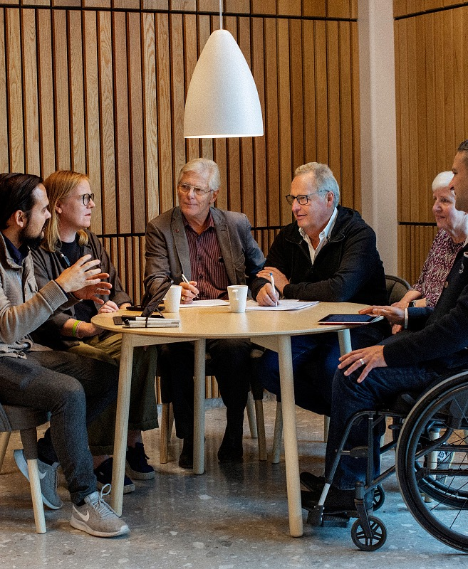
You influence what we do
Notes:
So how do we decide what to develop to make society ready for tomorrow? As mentioned earlier, Region Västra Götaland is a politically governed organization, which means that you influence what we do. That you are part of the decision-making.

Slide 27
Your vote guides us
15
149
850
REGIONAL ELECTIONS EVERY
4 years
Full-time representatives on the regional board
elected representatives on the regional council
representatives on boards, committees and preparatory committees
Notes:
You vote on who governs every 4 years
15 full-time representatives work on the regional board
develop a budget
decide on major investments
prepare matters for the regional council
149 full-time representatives work on the regional council
the highest decision-making assembly
ultimately responsible for the finances and the direction of the organization
decide which committees and boards etc. should exist
In addition, there are more than 850 representatives in committees, boards, commissions and preparatory committees

Slide 28
The elected representatives
The red-green coalition
The opposition
The Social Democrats
The Left Party
The Green Party
46 mandates
16 mandates
6 mandates
The Moderate Party
The Sweden Democrats
The Christian Democrats
The Centre Party
The Liberals
29 mandates
24 mandates
12 mandates
9 mandates
7 mandates
68
mandates
81
mandates
Notes:
In total, 149 elected politicians sit on the council. A majority requires 75 mandates or one vote more than half.
The current regional council received its political composition at the regional elections in the autumn of 2022. The Social Democrats, the Left Party and the Green Party govern Region Västra Götaland. The parties together hold 68 of the 149 mandates on the council and thus govern in a minority. The opposition consists of the Moderate Party, the Christian Democrats, the Centre Party, the Liberals and the Sweden Democrats, who together have 81 of the 149 mandates.
A decision requires either a majority or the highest number of votes. The members can also choose not to vote at all or to abstain. Decisions can therefore be made in several ways. With a minority government, the parties in opposition can vote down the leadership's proposals because they are more in number, but the leadership can also receive support from any of the parties in opposition, from some or even all of them.

Slide 29
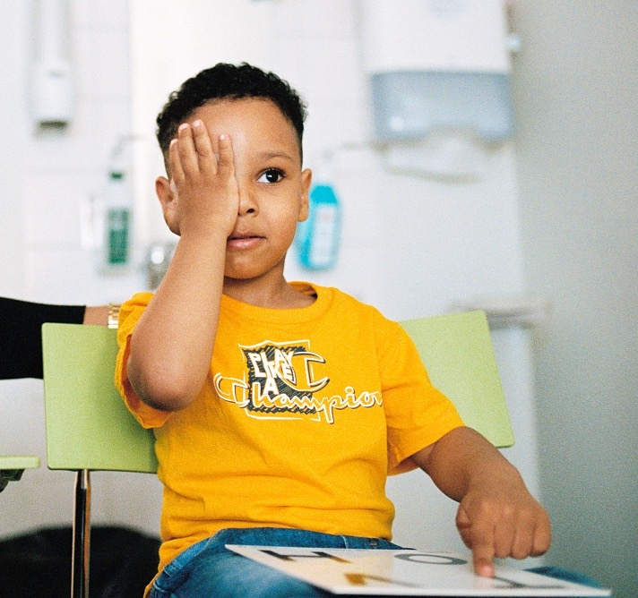
We are financed with your help
Budget for 2026:
90 billion SEK
more than half comes from taxes
Regional tax:
11.48 SEK
from every 100 SEK you earn
goes to Region Västra Götaland
Notes:
The image shows the adopted budget for 2026. Other revenues besides taxes include government grants, ticket revenues, patient fees and other revenues, such as sold healthcare services.

Slide 30
This is what you get for your tax money
87%
2%
Healthcare
Culture
9%
2%
Public transport
Education and regional development
Notes:
So what you get for your tax money?
• Healthcare = 87 percent
o Of which primary care 20 percent
o Of which specialized somatic care 48 percent
o Of which specialized psychiatric care 8 percent
o Of which dental care for children and youth up to age 19 3 percent
o Of which other healthcare 8 percent
• Education and regional development = 2 percent
• Culture = 2 percent
• Public transport (Traffic and infrastructure) = 9 percent

Slide 31
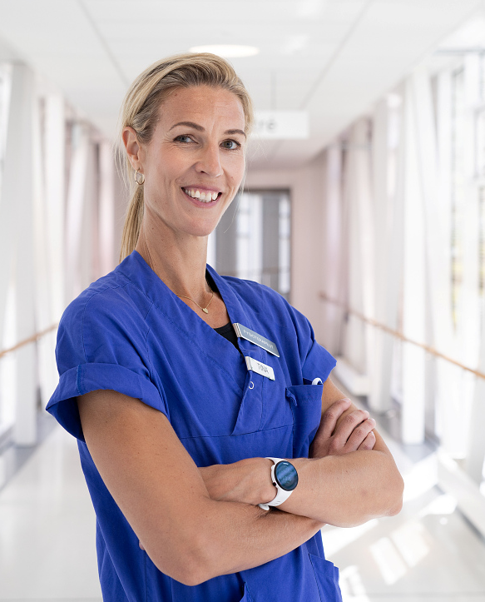
One of Sweden's largest employers – aiming to become the best
Notes:
But none of this would have been possible without the help of our co-workers – without them, we wouldn’t be able to make the will of the people a reality. So we have set an ambitious goal. We will become Sweden's best public employer. We're one of the biggest, but now we're also going to be the best.
We need to be the best in order to recruit, retain and develop employees with the right skills and to fulfil our mission towards residents and patients.

Slide 32
We will become Sweden's best public employer
200
56,000
professions
employees
Notes:
We employ around 56,000 people across more than 200 professions. They all make a difference in some way to the people around them.
In order to become Sweden's best public employer, we must naturally work actively to make things even better for our employees.
In our efforts to become a better employer, employees and managers have highlighted a number of areas we want to improve. It ranges from issues such as the work environment, respecting free time, making sure that employees feel that they receive the right compensation based on their work efforts, and that working time is used in the best possible way.
Not everything can be done at once, but in the long run we will be able to change.

Slide 33
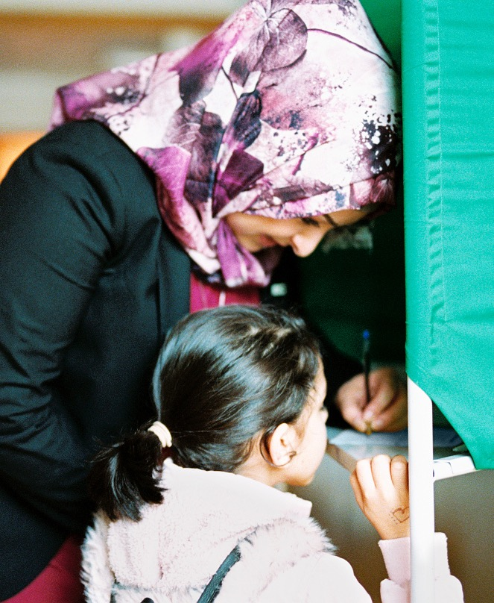
Close to you throughout your life, at the forefront of development and guided by your vote.
Notes:
In summary, you could say that we are close to you throughout your life, at the forefront of development, and guided by your vote.

Slide 34
Logo Region Västra Götaland

