Slide 1
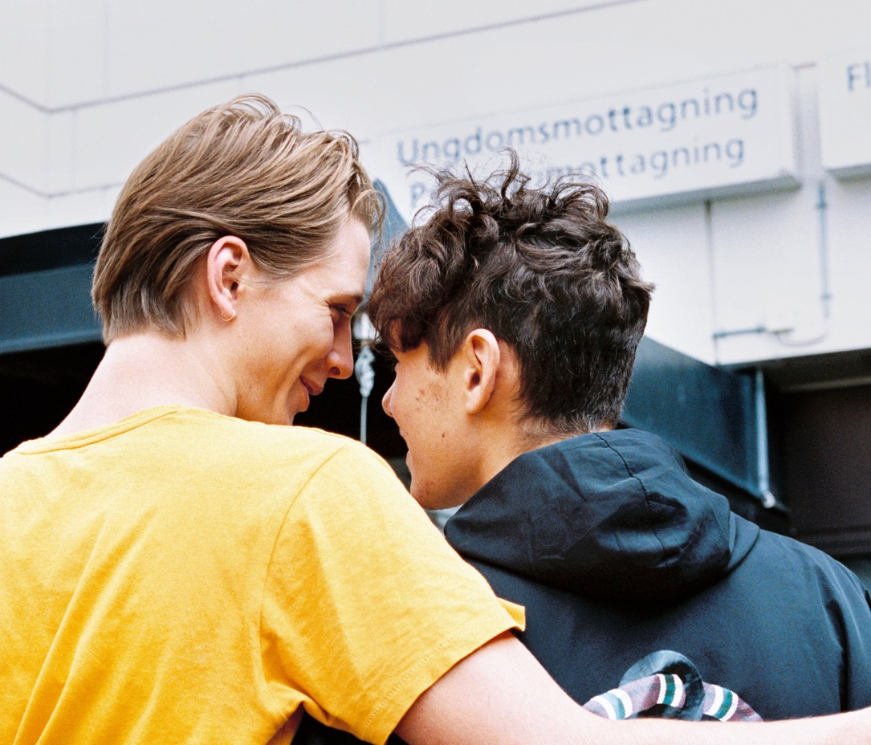
We are there for you who live in
Västra Götaland
Notes:
Facts from 2024 (Budget 2025)
Region Västra Götaland is there for you who live in Västra Götaland today.
Our 55,000 employees make us one of Sweden's largest public employers. Our mission is to contribute to a viable Västra Götaland and to the well-being of the 1.7 million people who live here.

Slide 2
When you need healthcare, you should get
the best. When you need to go somewhere,
you should be able to use public transport. When you want to experience culture, it should be close to you. When you study, it should be on your own terms. And when you live in Västra Götaland, sustainable development should go without saying.
Notes:
Let the image stay in the background when you introduce yourself.
We are close to you. And we have a big responsibility. When you need care, you should get the best. When you're going somewhere, you can choose sustainable ways to travel. When you want take part of culture, it should be close to you. When you study, it should be on your own terms and in your interest. And when you live in Västra Götaland, sustainable development should go without saying.

Slide 3
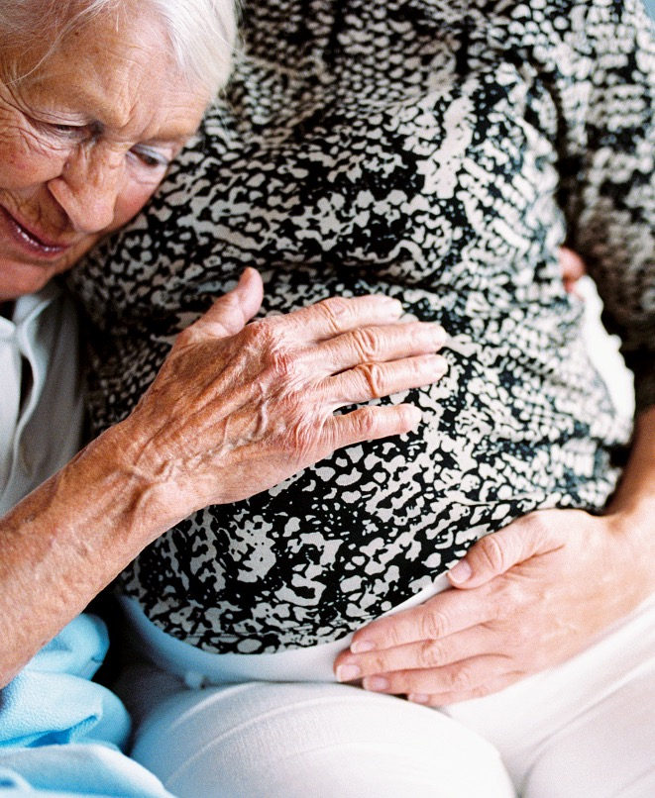
The best healthcare for everyone

Slide 4
When you need healthcare
On weekdays
On weekends and evenings
More than 200 health centers,
rehabilitation centers and
child healthcare centers
20 out-of-hour services
3 outpatient clinics
4 emergency clinics for dental care
In case of major care needs
Contact on your terms
17 hospitals, including
1 university hospital
Digital healthcare meetings with audio, video and chat
If you have complex needs
Oral health throughout life
In your home with mobile homecare
More than 153 Public dental care clinics
Notes:
We work closely with you to ensure that you have access to health and medical care.
On weekdays you can go to our health centers
On weekends and evenings you can get care at our out-of-hours service centers
Hospitals are available when you have major health needs.
You can get a good start in life with the help of our child health centers
Our public dentistry can help you keep your mouth and teeth healthy
and you can get back to everyday life with the help of the physiotherapists and occupational therapists at our rehabilitation clinics.

Slide 5
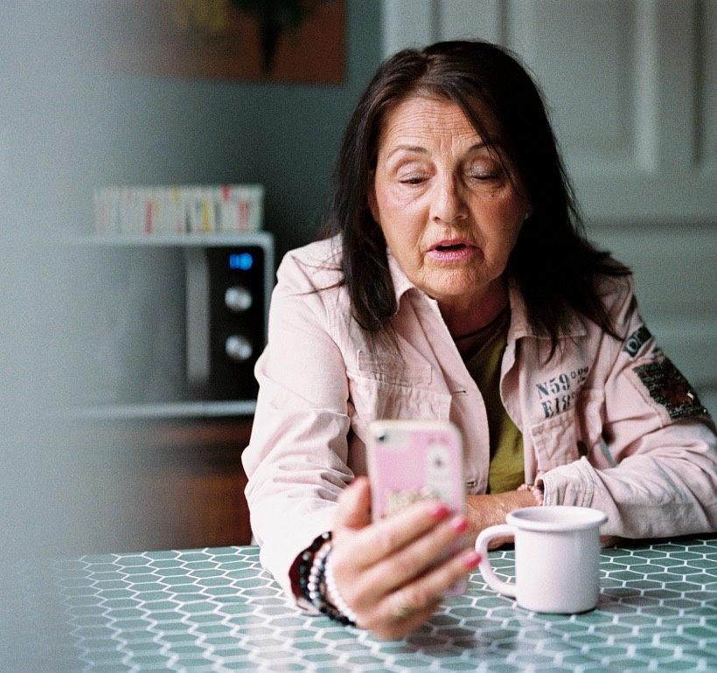
Modernizing health and medical care
Simplified systems
Specialized care in fewer places
New e-services
Care at home
Competence center for developing care
Notes:
In healthcare, we strive to make our work and organization smarter, and to provide a better and more accessible health and medical care. This is necessary to meet the needs of the future, as Västra Götaland's population grows. In addition, the largest population increases will be among children and people over 80, which are groups that need more care than others.
Currently, we are working to
simplify systems for collaboration, for example through a common medical record system across hospitals and primary care
concentrate parts of specialized care in fewer locations to ensure quality, patient safety and to increase efficiency.
introduce e-services in healthcare and in the contact with patients. For example, we have developed apps for digital meetings with primary care, psychologists and health coaches.
provide care at home to people who need it, to increase security and continuity
develop care, delivery and treatment through various competence centers, such as ones that focus on equal care, sexual health, mental health and domestic violence
It will free up time for healthcare professionals and make care more accessible to patients.

Slide 6
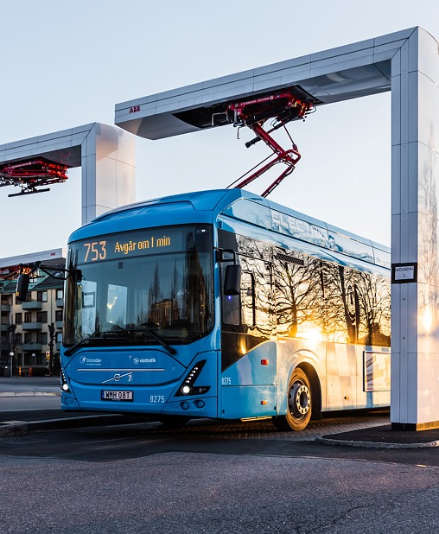
Public transport
– when you need to go somewhere
Notes:
For Västra Götaland to remain vibrant, public transport needs to work.
Our operational work in public transport is mainly carried out by our company Västtrafik.

Slide 7




When you need to go somewhere, you should be able to use public transport
For commuting and longer trips
Across the river and to islands
Västtågen has 14 lines and
7 express lines
7 lines in the Gothenburg area
To get around in cities
Ticket on your phone
233 trams, 11 lines
300,000 daily users
Notes:
Through Västtrafik, we make sure you can commute to work or school, go on outings or visit friends. That you can get from A to B by a suitable mode of transport.
We have buses, trams, ferries and trains.
And local transport, Närtrafik, if you live in the countryside
A full city bus is equivalent to a 300-metre car queue, a tram to a 700-metre car queue and a commuter train to a three-kilometer car queue. So when we work more with public transport means that there will be less traffic in the city.

Slide 8
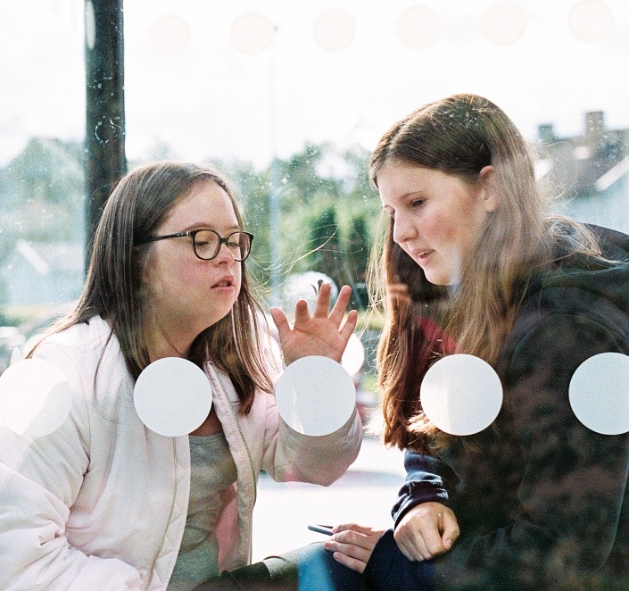
Developing of public transportation
Linking Västra Götaland
Getting more people to travel by public transport
Accessibility for all
Better options to combine modes of transport
More sustainable solutions
Electrification throughout the county
Notes:
We are developing public transport to ensure that you can choose sustainable modes of transport as West Sweden grows and the population increases.
Right now we are focusing our work on
linking Västra Götaland by means such as extended railways (Gothenburg–Borås, to Landvetter)
encouraging more people to choose public transport, for example by upgrading and expanding regional railways and making it easier to travel
making public transport more accessible regardless of disability
Improving availability for combined modes of transport, such as taking your bicycle with you on public transport
Developing public transport to be even more environmentally friendly and sustainable by using electric buses and biogas, etc.

Slide 9
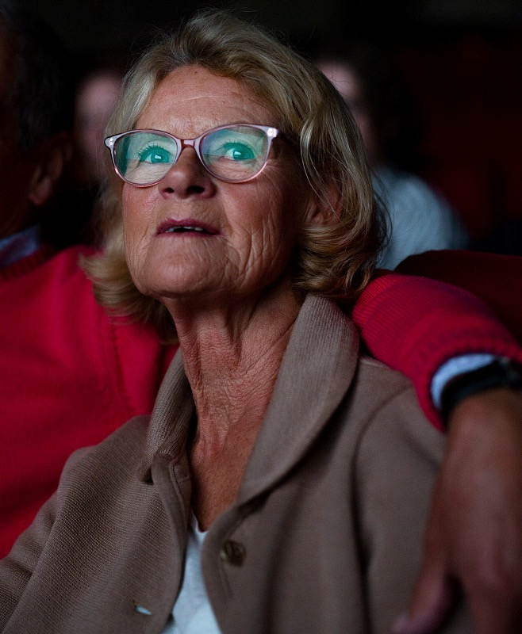
Culture that is close to you
Notes:
Another important part for health and spirit is culture. We work to ensure that culture is accessible in the region, especially for children and young people.

Slide 10
When you want to experience culture, it should be close to you
In schools
As a practititioner
Regionteater väst
Support and scholarships
On your phone
As an audience
Digital museum exhibitions
and live concerts
The Gothenburg Opera,
the Gothenburg Symphony Orchestra and Film i Väst
As an enthusiast
6 museums and attractions
Notes:
We have activities where you can experience all kinds of culture, from small to large.
Children and young people can experience the performing arts through Regionteater Väst.
Cultural practitioners can apply for grants and scholarships.
If you want to experience culture as an audience member, you can go to events such as the Gothenburg Opera's performances or listen to the Gothenburg Symphony Orchestra at the Gothenburg Concert Hall, both of which have touring activities to reach out around the region. If you watch a Swedish film, our company Film i Väst has most likely co-produced it.
If you want to learn more about history, nature or crafts, you can visit our museums and attractions (Gothenburg Museum of Natural History, Lödöse Museum, Forsviks Bruk, Crafts & Building Preservation, Vitlycke Museum, Vänersborg Museum).
You can even enjoy culture through your phone, for example digital museum exhibitions or GsO-play, where you can watch performances and concerts from the Gothenburg Symphony Orchestra online.

Slide 11

More accessible culture
We…
Have Sweden's largest cultural budget
Plan culture together with others
Want to create a broad and inclusive cultural life
Focus on culture for children and young people
Increase media and information literacy
Notes:
Culture plays an important role in society. It's not just about creativity, it's about challenging our assumptions and turning convention on its head. Access to culture is also defined as a human right and serves as a vehicle for democracy.
We…
work to make culture accessible to more people, no matter where they live in the county. Region Västra Götaland
has Sweden's largest cultural budget at a regional level.
regularly draw up plans and strategies for the development of cultural life, together with municipalities, professional associations, study associations and the independent cultural sector.
We…
work for a broad and inclusive cultural life
invest particularly in enabling children and young people to participate in and practice culture
are committed to increasing media and information literacy in society – citizens' source criticism is a prerequisite for a democratic society.

Slide 12
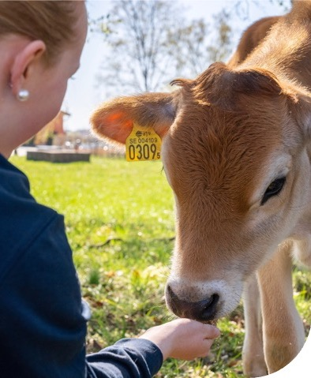
Study on your own terms
Notes:
Education also plays a role for both health and spirit. We work to enable you to train on your own terms and secure skills in certain areas.

Slide 13
When you study, it should be on your own terms
Animal husbandry
Recreation leader
+80
Health
Handicraft
Radio
courses
Music
Languages
General course
Marine biology
Land management
Theater
Outdoor life
Meal Attendant
Film Production
Notes:
In total, we have over 80 courses across our different schools. In addition to the folk high schools, we also run agricultural high schools and adult education courses in the green industries.
We also have options available to help non-Swedish speakers who have an education from a foreign country to enter the labor market, especially in the health sector.

Slide 14
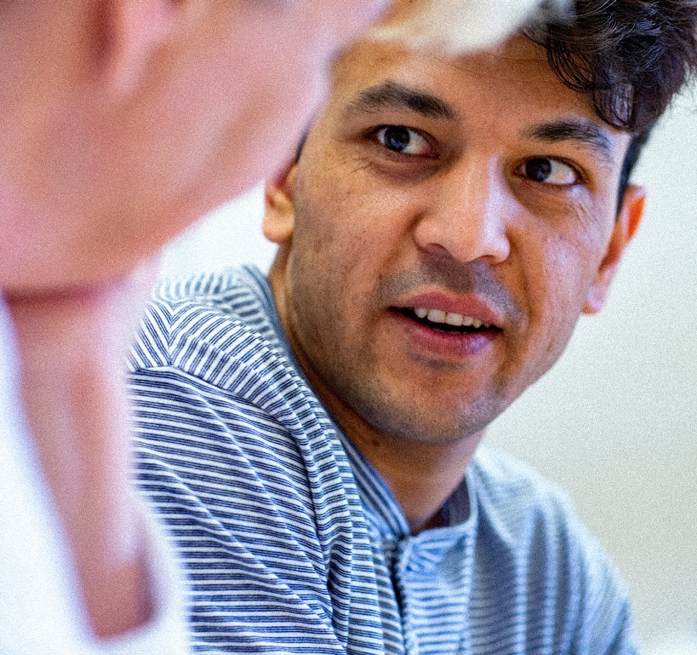
Education changes lives – so we are creating opportunities
All children have the right to an education
Everyone should be able to graduate from primary and high school with good grades
Supply of skills
Meeting places for research
Notes:
Society calls for training that matches the skills needed today and tomorrow. People having good opportunities to educate themselves makes both the individual and society stronger. It also improves public health.
We work to create the best opportunities for education. Among other things, we work together to ensure that all children and young people have access to education and consequently good opportunities in life.
We are working with “Kraftsamling fullföljda studier”, a joint effort to get more young people to graduate primary school with passing grades
We are working with the supply of skills to establish a properly working labor market, where training leads to the right skills and where everyone's skills are put to good use
We fund business and research venues to meet the needs of the future.

Slide 15
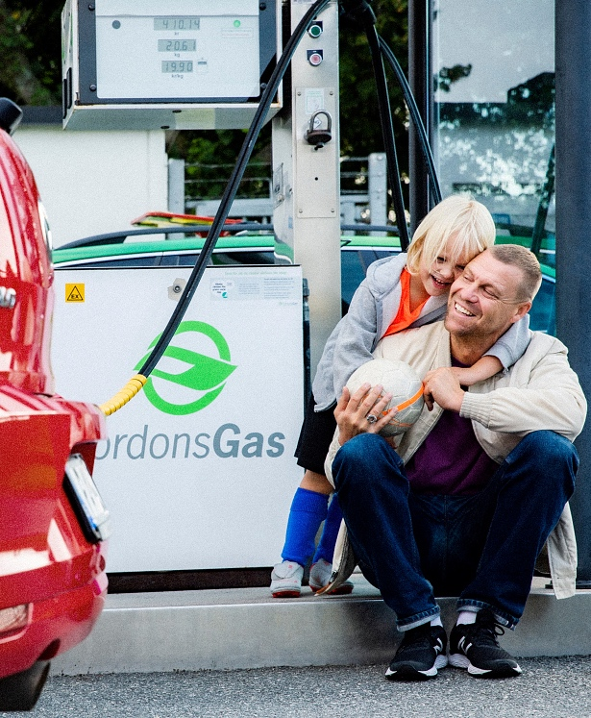
Sustainable development should go without saying
Notes:
When you live in Västra Götaland, sustainable development should be a matter of course.

Slide 16
When you live in Västra Götaland, sustainable development should go without saying
Close innovation
In an equal society
Research and science parks
Integration and human rights
Across the region
In everyday life
Rural development, regional spatial planning and the supply of skills
Sustainable transport and accessible destinations
For more opportunities
Toward a greener future
Support, grants and partnerships
Biogas Väst, Climate 2030, electrification
Notes:
What this means for you as a resident is that you can be certain that you are close to innovation, with research and science parks continuously looking for new solutions.
We are also working to ensure equal opportunities across the region – people should be able to live and earn a living in rural areas. Some issues such as spatial planning need to be examined at a regional level. The skills of all residents should be put to good use and matched with the labor market.
You should have opportunities to start your own business and be able to receive support and grants. For example, we provide support, advice and financing for young entrepreneurship. Grants for entrepreneurs with good ideas. Collaborations with different actors to foster good conditions for innovative business in the region.
In everyday life, sustainable transport and accessible destinations…
We work to ensure that you can live in an equal society through areas such as integration, accessible environments and human rights.
We work a lot with the environment, for example through Biogas Väst, Climate 2030 and climate-smart holidays.

Slide 17
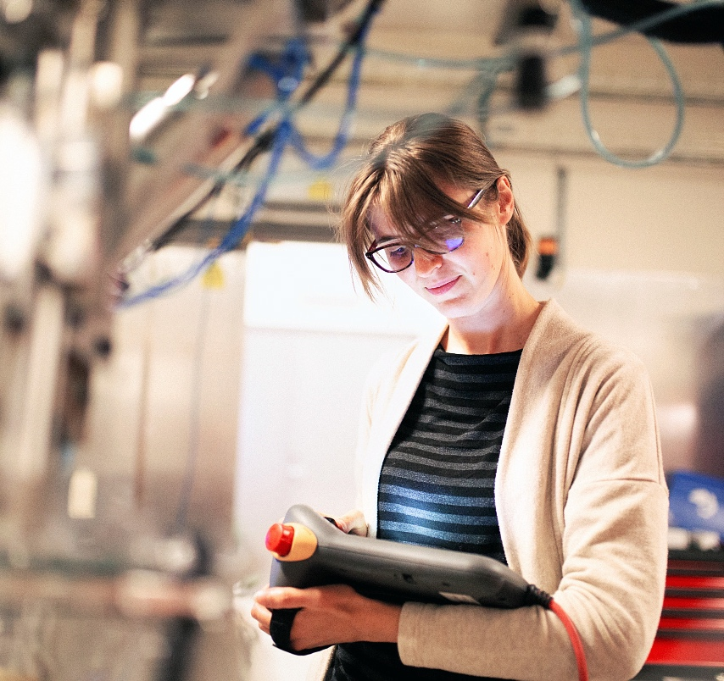
The world is changing – so we are developing society
Taking the lead in the climate transition
Contributing to a viable and sustainable economy
Respecting human rights
Developing broadband and telecom networks in rural areas
Notes:
The world is changing. That's why we are developing the region to make society keep up with the changes.
Right now we are focusing particularly on
taking the lead in the climate transition, including getting more stakeholders to make solid commitments, encouraging more cycling, walking and public transport, and creating better conditions for using electric vehicles. But also initiatives on sustainable fashion consumption and training on climate-smart food for grocery stores. We are part of the Climate 2030 coalition, which brings together companies, organizations, municipalities and others that want to take a stand and contribute to the transition to a climate-smart region. A climate-smart society provides competitive advantages, green jobs and it offers residents new ways to live a good life.
encouraging competitiveness, for example through working transport systems, but also by contributing to a viable and sustainable business community and by supporting research and innovative environments
human rights, e.g. with a focus on social sustainability, staff training on the Convention on the Rights of the Child and being the first to develop a regional human rights action plan. The plan contains twelve measurable objectives that we will aim to meet every year.
Increasing broadband take-up and improving mobile coverage in rural areas as a way to connect the region and reduce urban-rural divides

Slide 18

Big enough to act, close enough to understand
Notes:
The region is a political level between the municipality and the state. So what's so special about the regional level? It’s because we are big enough to act, close enough to understand.

Slide 19

Size + ambition =
POWER TO IMPLEMENT
Notes:
We are a large organization with around 55,000 employees
We are responsible for a large geographical area. Västra Götaland consists of 49 municipalities with 1.7 million inhabitants and covers an area 300 kilometers long and 250 kilometers wide. It's a size that provides us with resources.
Combined with a high ambition to drive and lead the development of society means that Region Västra Götaland as an organization has a great potential to influence the world around us – both in the market and on other political levels.
One of our guidelines is that decisions should be taken as close to you as possible. It also means that development takes place as close to you as possible.
You should receive the best possible care. Our size and subsequently our resources create the conditions for this. Conditions that have not existed at the municipal level before, with the added bonus that we are close enough to be able to adapt on a local level.
You should be able to travel easily between municipalities. We plan the infrastructure and public transport so that it will work accordingly.
You should be able to live in a sustainable society. Our coordination and development potential make this possible at a level larger than the municipality, but closer than the state.
Among other things.

Slide 20
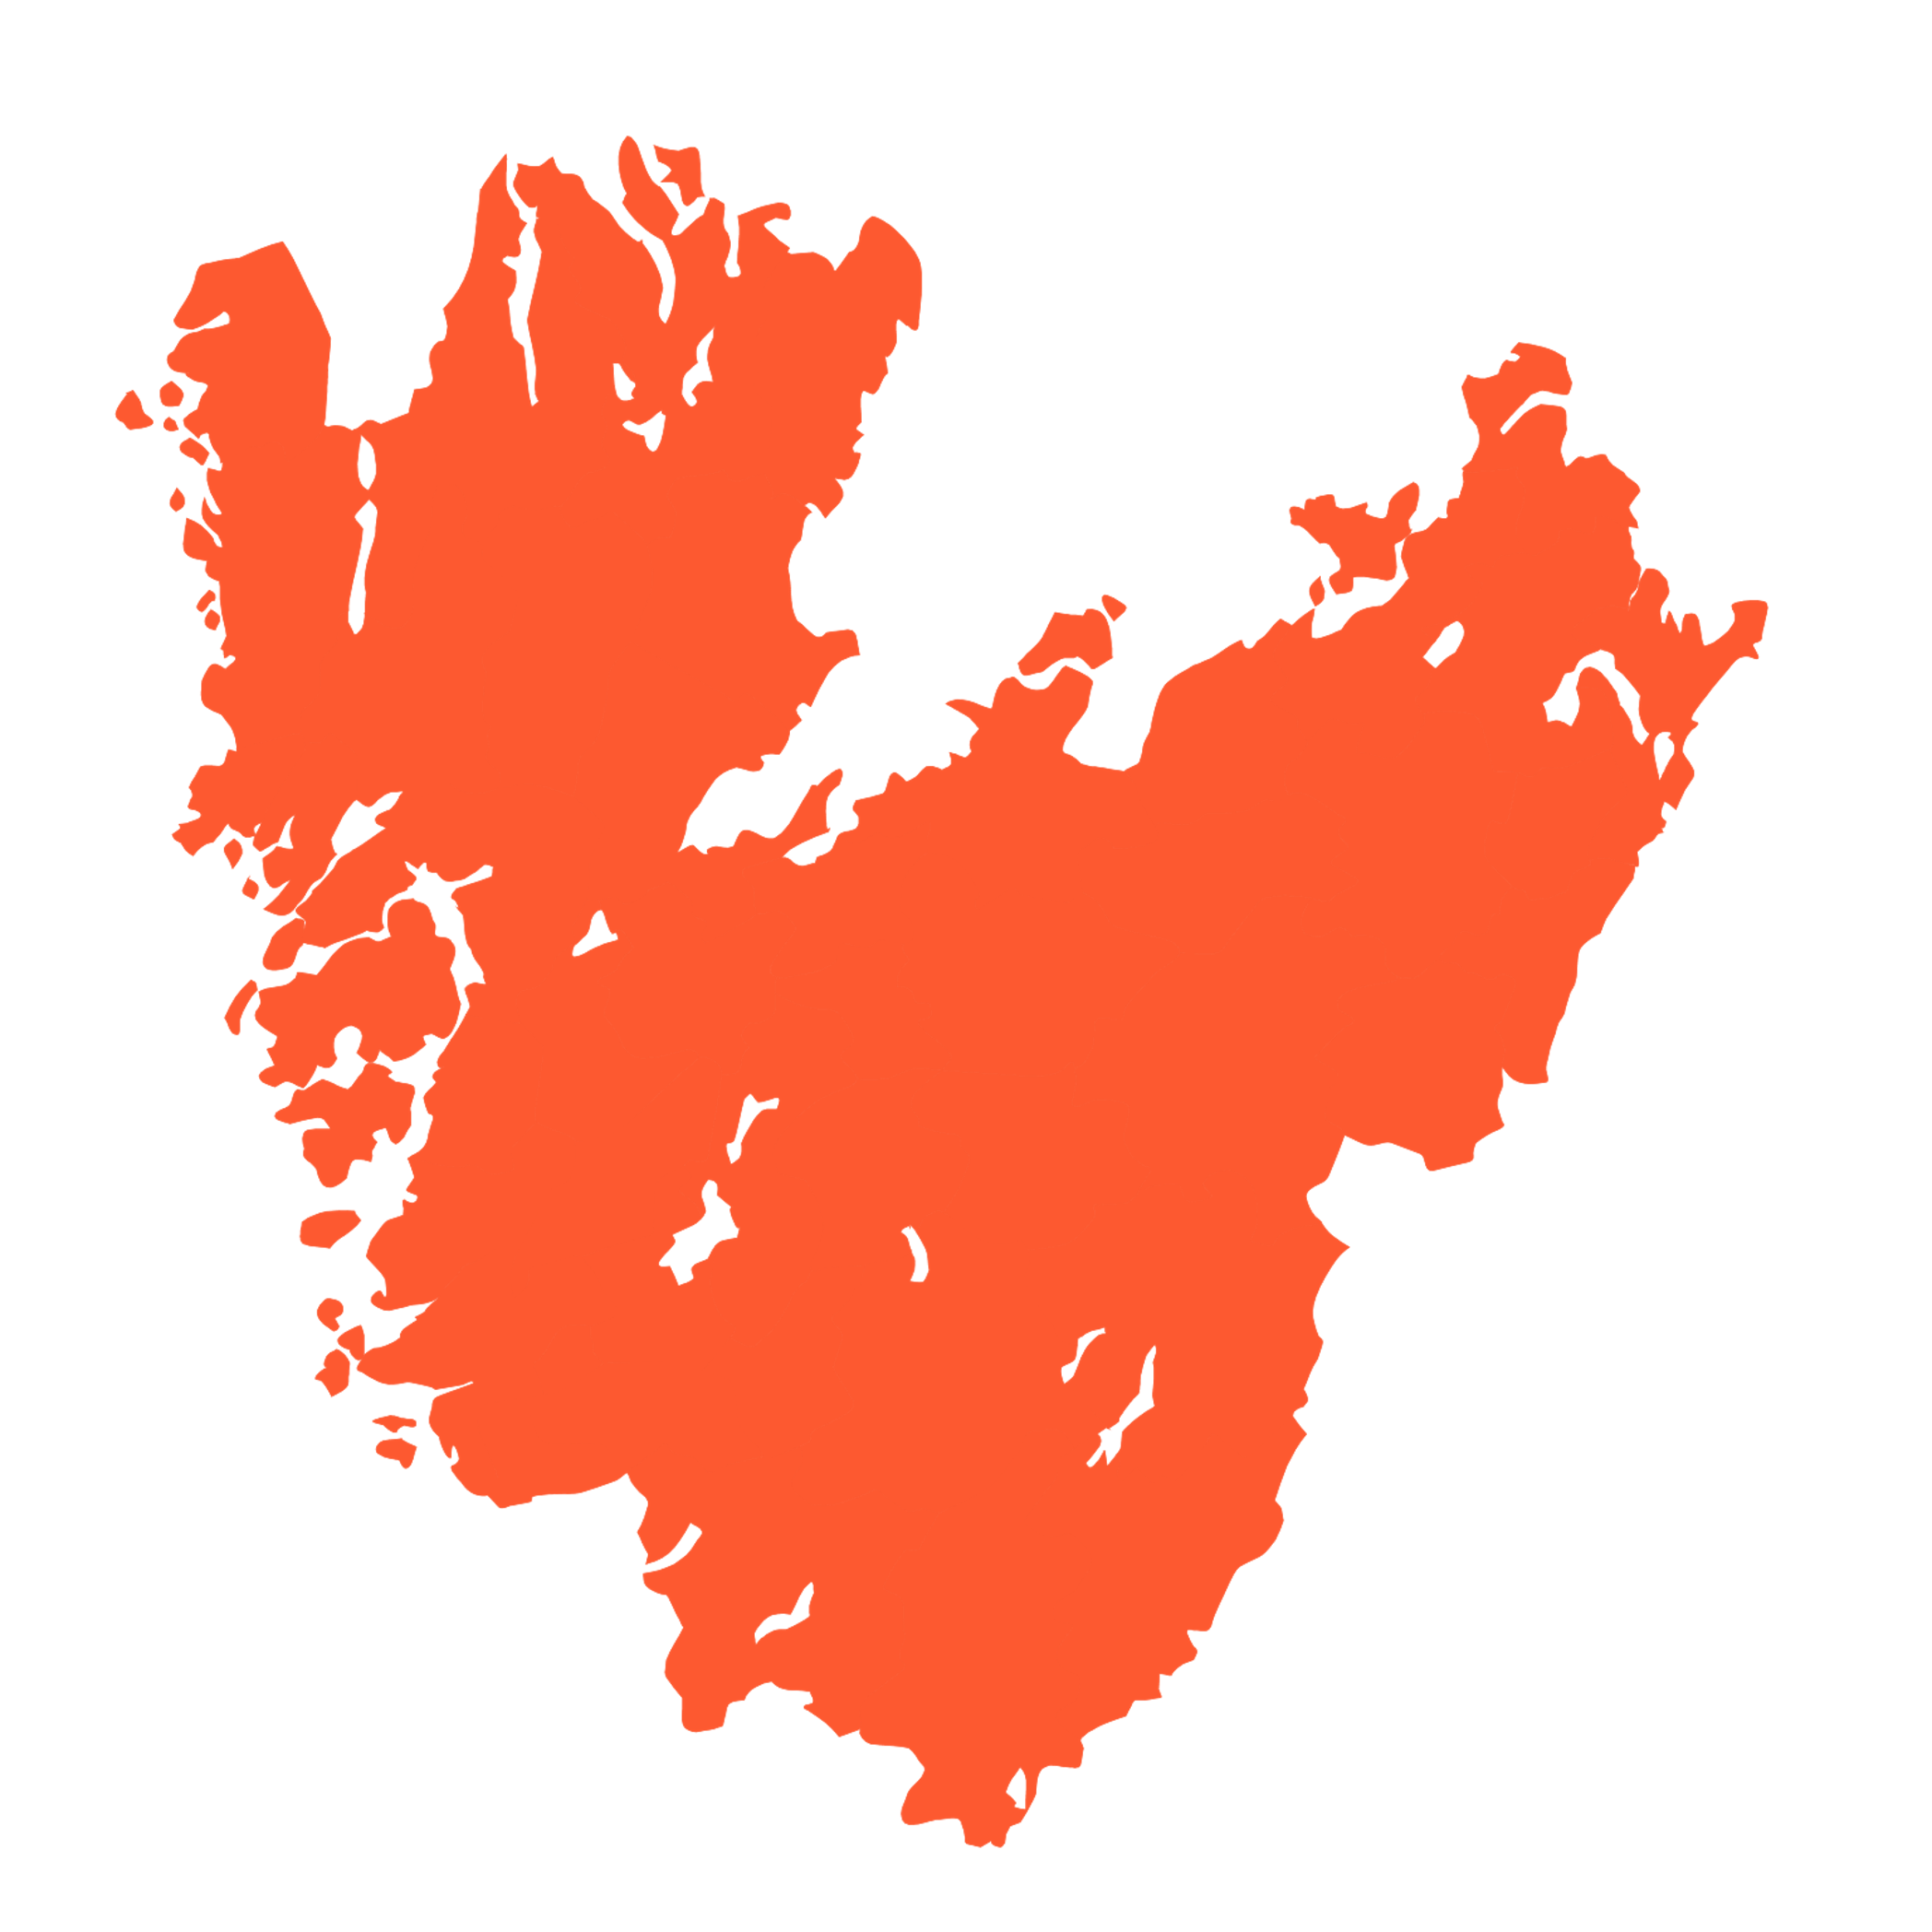




Everything is connected
Healthcare
Public
transport
Culture
Development
An attractive region
Notes:
Our five main areas of activity – healthcare, public transport, culture, education and development – all play a key role in making a functioning society. These five areas interact with and influence each other.
Being responsible for all five of these areas allows us to tackle the sustainability challenge as a whole and work on the three perspectives – ecological, economic and social – simultaneously.
Culture and education lead to better public health. Working transport systems, public transport and community development create the conditions for a competitive business sector.
Having an effective healthcare and public transport, together with access to culture, education and a sustainable society make us an attractive region.

Slide 21



Our size provides resources that drive us forward
More resources
A more attractive region
Better services
Notes:
Our size provides us resources which enable us to improve our services that make the region more attractive and attract business, innovation and new residents. Which in turn will give us more resources. A bit like a cycle.

Slide 22



Understanding is born in close conversation
In daily work
Collaboration in strategies
Citizens’ dialogue in development issues
Notes:
We are also close enough to understand, and understanding is born in conversation.
We engage in dialogue with those who live and work here, to understand their actual needs and wishes.
Our staff meet residents every day, which creates an understanding of a range of different situations.
When we establish development strategies in areas such as culture and climate, we cooperate with other actors such as organizations, communities and municipalities.
When it comes to major issues, we hold citizens' dialogues to find out what residents think and want – ranging from concepts in healthcare to the future of public transport.

Slide 23
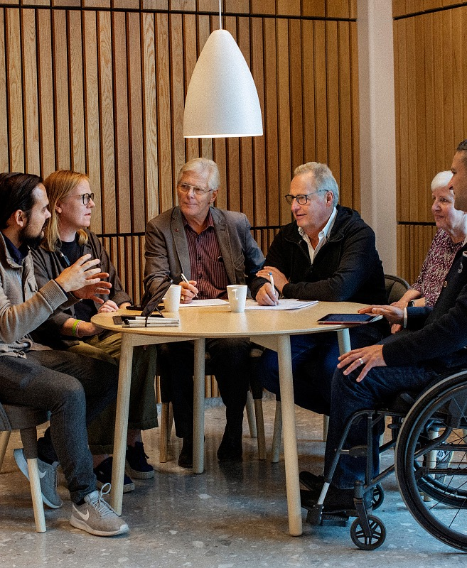
You influence what we do
Notes:
So how do we decide what to develop to make society ready for tomorrow? As mentioned earlier, Region Västra Götaland is a politically governed organization, which means that you influence what we do. That you are part of the decision-making.

Slide 24
Your vote guides us
REGIONAL ELECTIONS EVERY
15
149
850
4 years
Full-time representatives on the regional board
Elected representatives
on the regional council
representatives on boards, committees and preparatory committees
Notes:
You vote on who governs every 4 years
15 full-time representatives work on the regional board
develop a budget
decide on major investments
prepare matters for the regional council
149 representatives work on the regional council
the highest decision-making assembly
ultimately responsible for the finances and the direction of the organization
decide which committees and boards etc. should exist
In addition, there are more than 850 representatives on committees, boards, commissions and preparatory committees

Slide 25
The elected representatives
Red-green collaboration
Opposition
The Social Democrats
The Left Party
The Green Party
46 mandates
16 mandates
6 mandates
The Moderate Party
The Sweden Democrats
The Christian Democrats
The Centre Party
The Liberals
29 mandates
24 mandates
12 mandates
9 mandates
7 mandates
68
mandates
81
mandates
Notes:
As mentioned above, there are 149 elected representatives in the regional council, and 75 mandates are needed to have a majority.
The current regional council received its political composition at the election in autumn 2022. The Social Democrats, the Left Party and the Green Party govern the Västra Götaland region. The parties together have 68 of the 149 seats in the council. The opposition consists of the Moderate Party, the Sweden Democrats, the Christian Democrats, the Center Party and the Liberals.

Slide 26
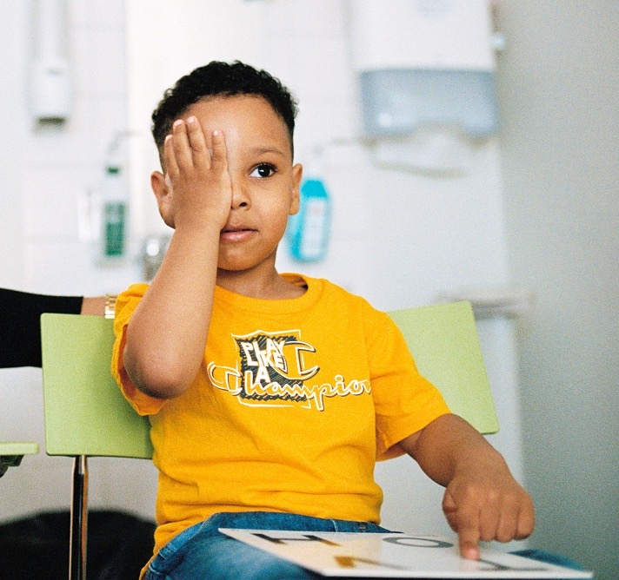
We are financed with your help
SEK 86 000,000,000
In revenue, mainly from the taxes
SEK 11,48
out of every SEK 100 you earn
Notes:
Other revenues include government grants, ticket revenues, patient fees and other revenues such as sold care services

Slide 27
This is what you get for your tax money
86 %
2 %
Health and medical care
Culture
10 %
2 %
Public transport
Education and regional development
Notes:
So what you get for your tax money?
• Health and medical care = 86 %
• Education and regional development = 2 %
• Culture = 2 %
• Public transport (Trafik och infrastruktur) = 10 %

Slide 28
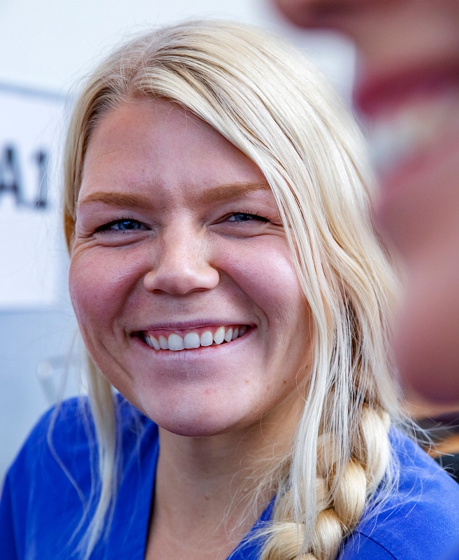
Our ambition – Sweden’s best public employer
Notes:
But none of this would have been possible without the help of our co-workers – without them, we wouldn’t be able to make the will of the people a reality. So we have set an ambitious goal. We will become Sweden's best public employer. We're one of the biggest, but now we're also going to be the best.
We need to be the best in order to recruit, retain and develop employees with the right skills and to fulfil our mission towards residents and patients.

Slide 29
We will become Sweden's best public employer
200
57 000
professions
employees
Notes:
We employ around 55,000 people. They all make a difference in some way to the people around them.
In order to become Sweden's best public employer, we must work actively to make things even better for our employees.
In our efforts to become a better employer, employees and managers have highlighted a number of areas we want to improve. It ranges from issues such as the working environment, freeing up leisure time, making sure that employees feel that they receive the right compensation based on their efforts, and that working time is used in the best possible way.
Not everything can be done at once, but in the long run we will be able to change.

Slide 30
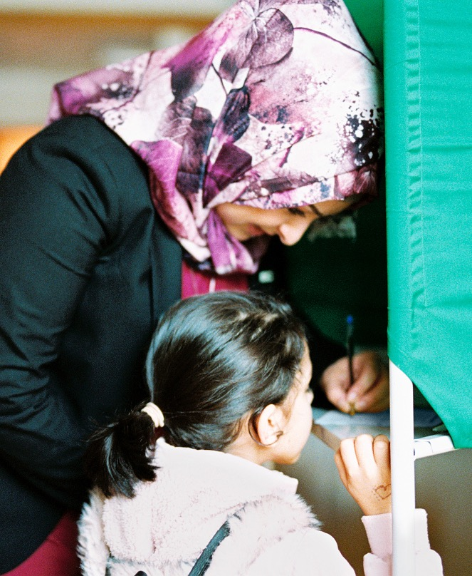
Close to you throughout your life, at the forefront of development and guided by your vote.
Notes:
In summary, you could say that we are close to you throughout your life, at the forefront of development, and guided by your vote.

Slide 31
Logotyp Västra Götalandsregionen

