Slide 1
Notes:
The Regional Development Strategy is the shared strategy for regional development in the Västra Götaland region. The Strategy is based on the mandate given to Region Västra Götaland by the Government to develop and adopt a regional development strategy for the region, as well as to coordinate its implementation and follow-up. This mandate is set out in the Act (2010:630) and the Ordinance (2017:583) on Regional Development Responsibility.
The Regional Development Strategy guides and brings together municipalities, municipal federations, the business sector, academia and research institutes, civil society organisations, as well as the County Administrative Board and other government agencies in a shared effort to promote regional development. Together with the regional budget adopted by the Regional Council, the Strategy governs Region Västra Götaland’s investments in regional development.
The Strategy is based on Vision Västra Götaland – A Good Life. A good life includes good health for residents, employment and education, sustainable development, safety, community and participation in social life, a good environment where renewable systems are safeguarded, a vibrant cultural life, and a society that meets the needs of children and young people.
A good life presupposes sustainable development, where economic, social and environmental sustainability are interdependent and mutually reinforcing.
The Regional Development Strategy contributes to the regional implementation of international, European, and national development strategies.
At the global level, the 2030 Agenda with its 17 Sustainable Development Goals provides the overarching framework.
At the national level, the Regional Development Strategy contributes to the National Strategy for Sustainable Regional Development throughout Sweden 2021–2030.
Regional policy documents
2
The Regional Development Strategy is aligned with three other regional policy documents adopted by the Regional Council. Together, they will contribute to realising our shared Vision Västra Götaland – A Good Life. The policy documents are:
The Västra Götaland Cultural Strategy and Cultural Plan is the overarching policy document for culture, democratic development and civil society issues.
The Transport Provision Programme 2026–2029 – Public Transport Strategy for Västra Götaland is the overarching policy document for the development of public transport.
The Strategy for the Transformation of the Healthcare System in Region Västra Götaland is the overarching policy document for the development of healthcare towards person-centred and integrated care,

Slide 2
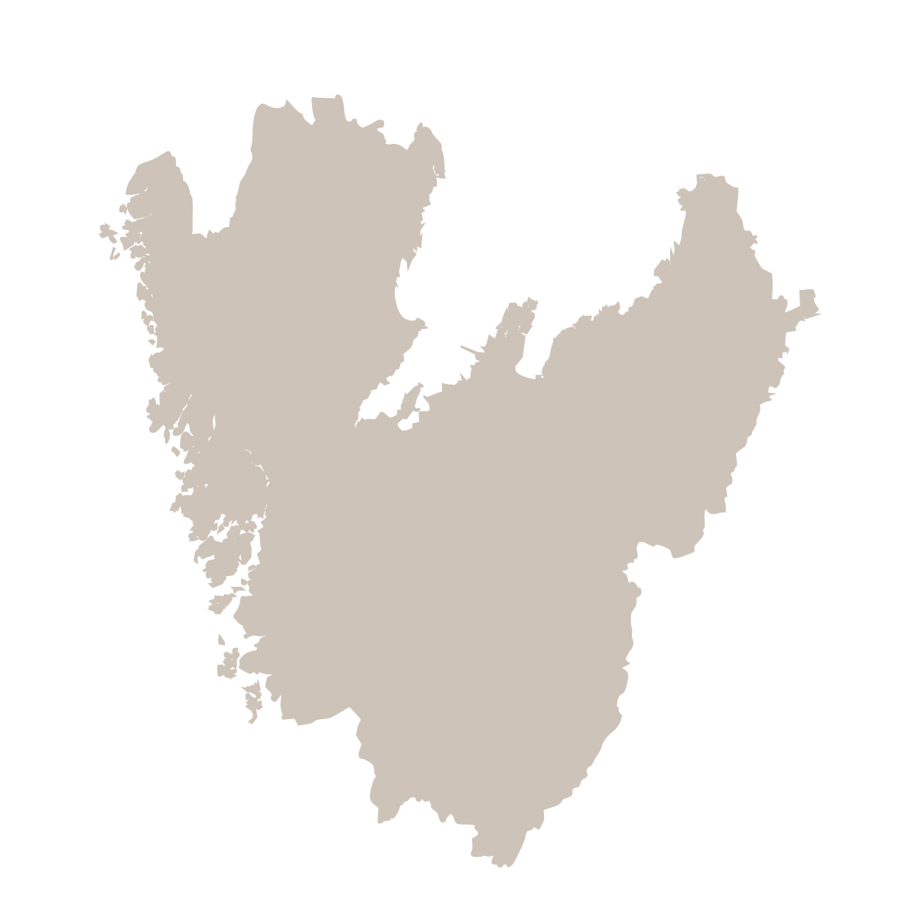
Regional Development Strategy for Västra Götaland 2021-2030, looking ahead to 2045
A shared strategy for regional development in the Västra Götaland region.
Based on the mandate given to Region Västra Götaland by the Government to develop and adopt a regional development strategy for the region.
49 municipalities, the four local municipal federations, industry and its organisations, academia and research institutes, the civil society, Region Västra Götaland, and other government bodies.​
The strategy goal and four long-term priorities sets out the shared direction for Västra Götaland´s transition towards a sustainable and competitive society.
Notes:
The Regional Development Strategy is our shared strategy for regional development in the Västra Götaland region.
The Strategy is based on the mandate given to Region Västra Götaland by the Government to develop and adopt a regional development strategy for the region, as well as to coordinate its implementation and follow-up. This mandate is set out in the Act (2010:630) and the Ordinance (2017:583) on Regional Development Responsibility.
The Regional Development Strategy guides and brings together municipalities, municipal federations, the business sector, academia and research institutes, civil society organisations, as well as the County Administrative Board and other government agencies in a shared effort to promote regional development.
Together with the regional budget adopted by the Regional Council, the Strategy governs Region Västra Götaland’s investments in regional development.

Slide 3
49 municipalities
Business sector and its organisations
Municipal federation
Responsibility is shared
To achieve impact, we need many actors working together. While we all have different mandates and resources at our disposal, responsibility is shared.
Civil society organisations
Academia and Research institutes
the County Administrative Board,
and other government agencies
Region Västra Götaland
Notes:
The Regional Development Strategy sets out our shared direction for the transition to a sustainable and competitive society. To achieve impact, we need many actors working together to drive development in the same direction. While we all have different mandates and resources at our disposal, responsibility is shared. Together, we can accelerate the pace of the transition through strengthened dialogue and collaboration, sustained commitment, and joint initiatives.
The Regional Development Strategy guides and brings together municipalities, municipal federations, the business sector, academia and research institutes, civil society organisations, as well as the County Administrative Board and other government agencies in a shared effort to promote regional development.
Together with the regional budget adopted by the Regional Council, the Strategy governs Region Västra Götaland’s investments in regional development.

Slide 4
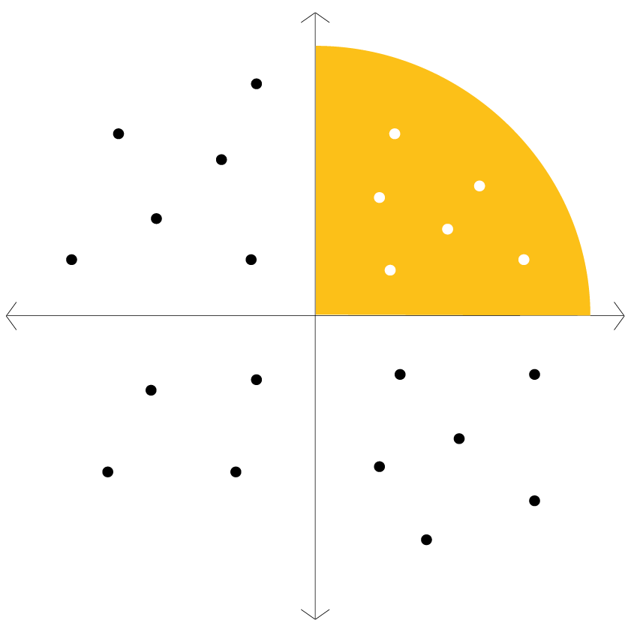
The Strategy prioritises areas that are of long-term strategic importance for the development of Västra Götaland and where collaboration between different actors and joint efforts are required to successfully transition to an economically, socially, and environmentally sustainable and competitive society.
LONG-TERM
Regional Development Strategy
INDIVIDUAL ACTOR
COLLABORATION REQUIRED
SHORT-TERM
Notes:
The Strategy prioritises areas that are of long-term strategic importance for the development of Västra Götaland and where collaboration between different actors and joint efforts are required to successfully transition to an economically, socially, and environmentally sustainable and competitive society.

Slide 5


Uncertain global landscape
Demographic developments
Acute threat to biodiversity
Widespread organised crime
Tougher global competition
Climate change
Digital transformation
Young people not completing their education
Notes:
Västra Götaland has a strong starting point, but we also need to address several regional and global challenges. This means that major societal systems need to be transformed and fundamentally restructured, not least to limit global warming and the rapid loss of biodiversity.
The complexity of most societal challenges means that innovative solutions need to be developed collaboratively across sectors, drawing on Västra Götaland’s overall capacity for transition and the region’s unique conditions and strengths.
During 2024-2025 yhe Strategy was updated to reflect recent global developments and changes in the conditions shaping development in Västra Götaland, drawing on sources such as evidence-based analyses, environmental scanning, and stakeholder dialogues. The revised strategy highlights challenges related to a growing geopolitical uncertainty, demographic change, increasing global competition, the digital transformation of society, and the increasingly evident societal impacts of climate change and biodiversity loss.
The Strategy is based on the following societal challenges:
The effects of climate-impacting emissions are increasing, and biodiversity is under acute threat, with increasingly serious consequences at the societal level.
An uncertain global landscape, marked by a growing number of serious crises and geopolitical conflicts, places new demands on society and the business sector, including the need for enhanced preparedness.
Demographic developments, including declining birth rates, increased life expectancy, and a smaller proportion of the population of working age, create challenges for maintaining the welfare system and ensuring the business sector’s skills provision.
There is a significant shortage of certain skills, while many people are unemployed.
Västra Götaland’s economy and its business sector face tougher global competition, rapid changes in value chains, and increased demand for key competencies. Maintaining jobs and the region’s leading position in research, innovation, and development requires both efficiency and increased investment.
The digital transformation and developments in AI and other breakthrough technologies are advancing rapidly, affecting all parts of society. This creates new opportunities but also entails ethical dilemmas and risks, including in the area of cybersecurity.
The need to develop transport infrastructure, particularly railways and public transport, remains considerable. Long lead times and a general lack of funding require alternative approaches and solutions.
Access to employment and public services varies across the region. Socioeconomic disparities need to be reduced, and all residents need to feel included in society.
Trust in society and democracy risks declining as a result of both the increasing spread of false or misleading information and widespread organised crime.
A growing proportion of young people are worried about the future and dissatisfied with their lives. Too many children and young people experience poor mental health. Many do not complete their education. Children are being recruited into criminal gangs at ever younger ages.
Strategin tar sin utgångspunkt i följande samhällsutmaningar:
Effekterna av klimatpåverkande utsläpp ökar och den biologiska mångfalden är akut hotad med alltmer allvarliga konsekvenser på samhällsnivå.
Det osäkra världsläget med fler allvarliga kriser och geopolitiska konflikter ställer nya krav på samhälle och näringsliv, bland annat kring stärkt beredskap.
Den demografiska utvecklingen med minskande födelsetal, ökad medellivslängd och lägre andel befolkning i yrkesverksam ålder leder till utmaningar att klara välfärdens uppdrag och näringslivets kompetensförsörjning. Bristen på vissa kompetenser är stor, samtidigt som många saknar arbete.
Västsveriges ekonomi och näringsliv står inför hårdare global konkurrens, snabb förändring i värdekedjor och ökade krav på nyckelkompetenser. För att behålla jobben och länets ledande position inom forskning, innovation och utveckling krävs effektivitet och stärkta satsningar.
Den digitala transformationen, utvecklingen inom AI och andra banbrytande teknologier går snabbt och påverkar alla delar i samhället. Det öppnar nya möjligheter men innebär också etiska dilemman samt risker inom exempelvis cybersäkerhet.
Utvecklingsbehoven för transportinfrastruktur, särskilt för järnväg och kollektivtrafik, är fortsatt stora. Långa ledtider samt en generell brist på finansiering ställer krav på alternativa arbetssätt och lösningar.
Invånarnas tillgång till arbete och samhällsservice skiljer sig åt inom länet. Socioekonomiska klyftor behöver minska och invånare känna sig delaktiga i samhället.
Tilliten till samhället och demokratin riskerar att minska i takt med dels ökad spridning av falsk eller vilseledande information, dels utbredd organiserad brottslighet.
En ökande andel unga känner oro för framtiden och är inte nöjda med livet. Alltför många barn och unga upplever psykisk ohälsa. Många klarar inte skolan. Allt yngre personer rekryteras till kriminella gäng.

Slide 6
Strategy goal
Notes:
The Strategy goal sets out the direction ahead and addresses the need for Västra Götaland to transition towards a sustainable and competitive society.

Slide 7
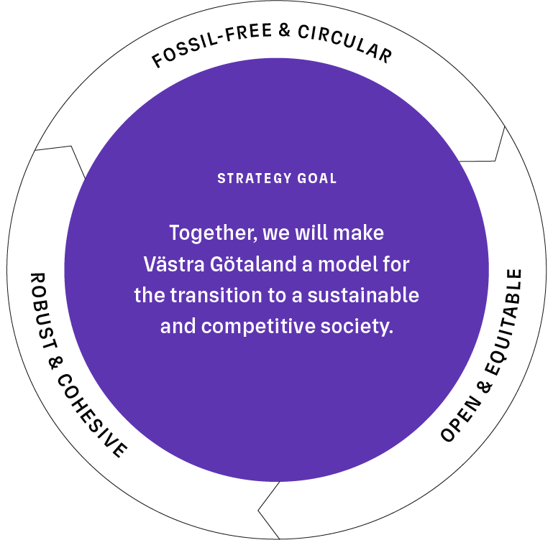
Strategy goal
Notes:
The Strategy goal sets out the direction ahead and addresses the need for Västra Götaland to transition towards a sustainable and competitive society. The key to a competitive and attractive Västra Götaland in the long term is our collective capacity for innovative transition across a wide range of areas. Drawing on the region’s combined strengths, established collaborative structures, and our shared capacity for transition, we have the opportunity to take the lead and serve as a model. This helps ensure that everyone who lives and works in Västra Götaland has the opportunity to live a good life.
The Strategy’s goal is stated as follows: “Together, we will make Västra Götaland a model for the transition to a sustainable and competitive society.” The goal sets out the direction for Västra Götaland to 2030, looking ahead to 2045, because long-term commitment is required when collaborating to address complex challenges and support the transition of society.
The goal clarifies what such a transition entails from an economic, environmental, and social perspective.
A Västra Götaland in transition is robust and cohesive, open and equitable, fossil-free and circular.

Slide 8
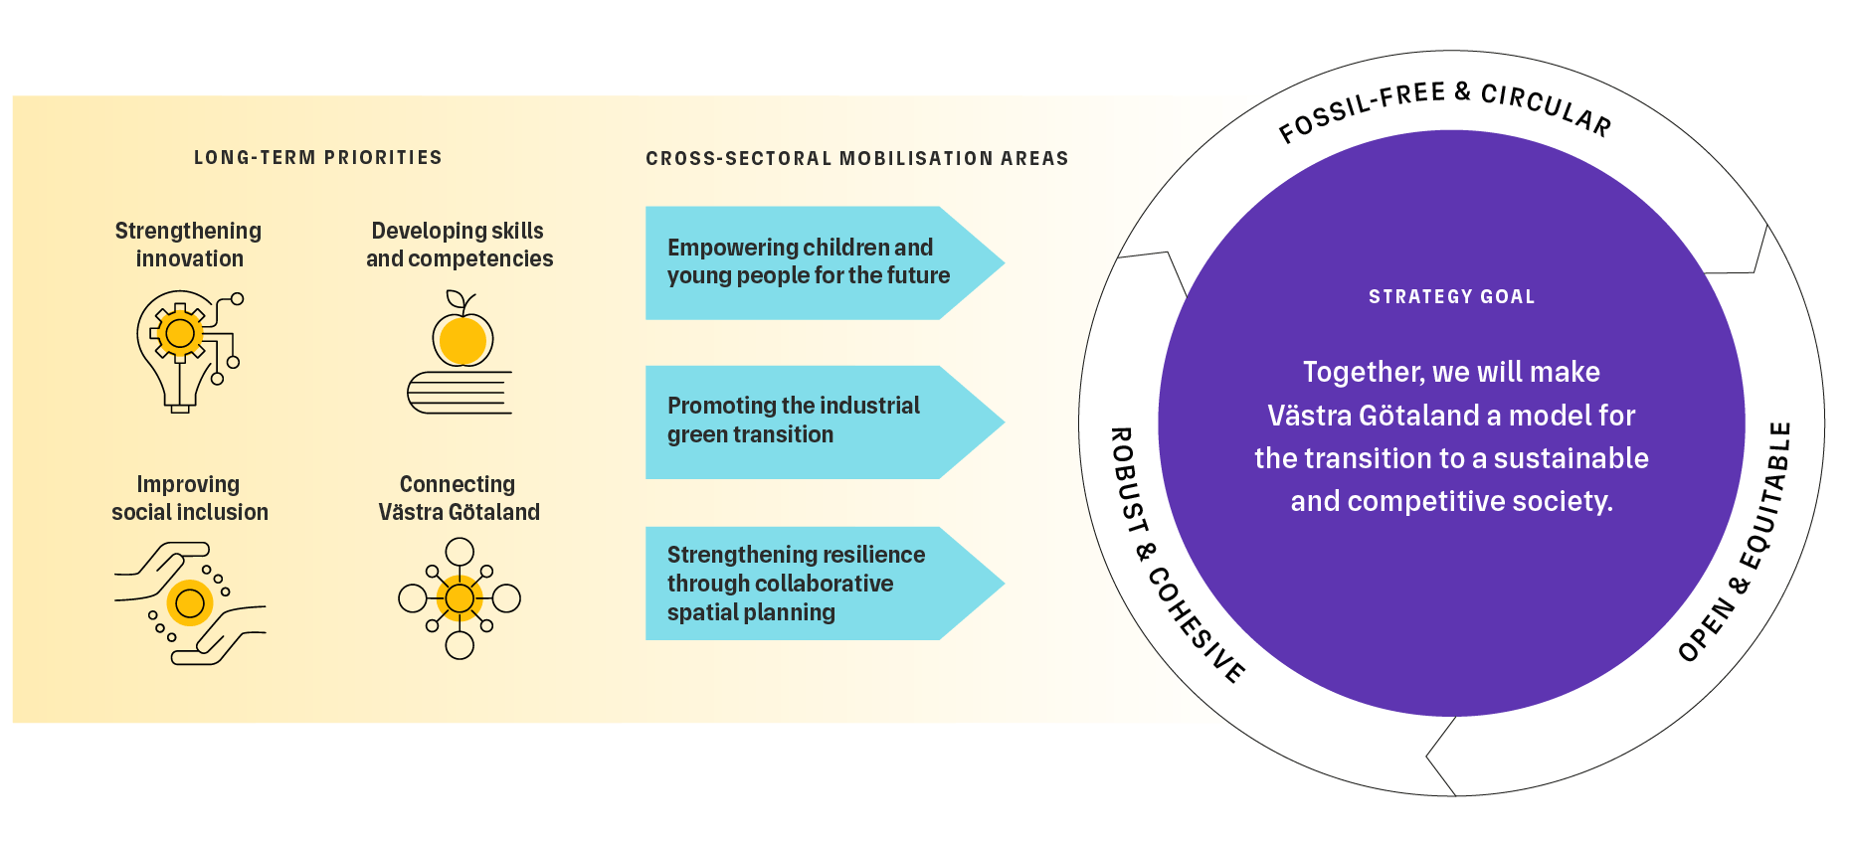
Regional Development Strategy for Västra Götaland 2021-2030 – Looking ahead to 2045
Notes:
The Regional Development Strategy sets out the direction for our collective efforts to promote the development of Västra Götaland. The Strategy consists of one goal, four long-term priorities, and three cross-sectoral mobilisation areas.
The Strategy’s goal sets the direction to 2030, looking ahead to 2045, and addresses the need for Västra Götaland to transition towards a sustainable and competitive society. The Strategy’s goal is stated as follows: “Together, we will make Västra Götaland a model for the transition to a sustainable and competitive society.” The goal clarifies what such a transition entails from an economic, environmental, and social perspective. A Västra Götaland in transition is robust and cohesive, open and equitable, fossil-free and circular.
The goal clarifies what such a transition entails from an economic, environmental, and social perspective.
The four long-term priorities describe the areas that form the foundation of Västra Götaland’s coordinated and strategic regional development efforts. These areas are interconnected and require strategic collaboration and joint efforts to succeed in the transition to a sustainable and competitive society. They long-term priorities are:
Strengthening innovation – for a competitive business sector at the forefront
Developing skills and competencies – for improved skills provision and lifelong learning
Improving social inclusion – for trust and cohesion
Connecting Västra Götaland – for improved and sustainable accessibility
The Strategy identifies three mobilisation areas for the period 2026–2030, where we over the coming years particularly need to focus on strengthening collaboration and coordinating development efforts to achieve greater impact. The three mobilization areas are:
Empowering children and young people for the future
Promoting the industrial green transition
Strengthening resilience through collaborative spatial planning

Slide 9
Implementation
Notes:
Implementation – through dialogue and collaboration, based on knowledge and learning.
Four guiding principles challenge and guide us.
The Strategy is implemented by the business sector and its organisations, the region’s 49 municipalities and four municipal federations, academia and research institutes, civil society organisations, Region Västra Götaland, the County Administrative Board, and other government agencies.
To achieve impact, we need many actors working together to drive development in the same direction. While we all have different mandates and resources at our disposal, responsibility is shared.

Slide 10
Implementation – through dialogue and collaboration
Notes:
The Regional Development Strategy sets out our shared direction for the transition to a sustainable and competitive society. To achieve impact, we need many actors working together to drive development in the same direction. While we all have different mandates and resources at our disposal, responsibility is shared. Together, we can accelerate the pace of the transition through strengthened dialogue and collaboration, sustained commitment, and joint initiatives. We need to challenge ourselves to work and collaborate in new ways, broaden our perspectives, be courageous, lead the way, and explore uncharted territory.
The Strategy is implemented by the business sector and its organisations, the region’s 49 municipalities and four municipal federations, academia and research institutes, civil society organisations, Region Västra Götaland, the County Administrative Board, and other government agencies. We drive development forward based on the challenges we face together, and specify and prioritise the Strategy’s content through sub-strategies, action plans and agreements. This enables active collaboration and partnerships within and across sectors. We need to allocate human and financial resources in our budgets and plans. There is also a need for coordination that links governance at the local, regional, national and European levels.
The figure illustrates the implementation of the Strategy, with continuous dialogue and collaboration at its core. Knowledge and learning interact with and inform the initiatives we undertake using our various resources and tools. The guiding principles below the figure guide us in the implementation.
The guiding principles are:
We make the most of the unique conditions and potential of different places.
We increase public engagement and influence in decision-making.
We experiment to learn, scale, and implement
We are all courageous leaders of change.
The principles should guide our dialogue and collaboration in implementing it. These principles help us make the most of opportunities across Västra Götaland by inspiring and challenging us to work and collaborate in new ways. They should help broaden perspectives, increase participation, and encourage us to lead the way and dare to explore uncharted territory.

Slide 11

Four guiding principles challenge and guide us
We make the most of the unique conditions and potential of different places.
We increase public engagement and influence in decision-making.
We experiment to learn, scale, and implement
We are all courageous leaders of change
Notes:
The Strategy sets out four principles to guide our dialogue and collaboration in implementing it. These principles help us make the most of opportunities across Västra Götaland by inspiring and challenging us to work and collaborate in new ways. They should help broaden perspectives, increase participation, and encourage us to lead the way and dare to explore uncharted territory. The guiding principles also support the integration of the 2030 Agenda into implementation.
We make the most of the unique conditions and potential of different places.
Västra Götaland is a large region with a range of opportunities and challenges linked to the conditions of different places. This diversity should be harnessed, which requires making the various development needs visible. We need effective collaboration across territorial boundaries and policy areas, based on the issues we must address together. This may involve challenging established administrative boundaries. Through collaboration between localities with different strengths and functions, development can take place both locally and across Västra Götaland as a whole. Cultural life as a unifying force helps bridge boundaries.
We increase public engagement and influence in decision-making.
For the transition efforts to be sustainable in the long term, residents must have the opportunity to participate, have influence and contribute to societal development. The right to participation also applies to children and young people, who should be given opportunities to be involved in matters that affect them, in ways appropriate to their circumstances. Inclusion promotes people’s health and strengthens democracy. We work together to ensure that as many people as possible are able to take part in the implementation of the Strategy and make their voices heard. Only then can our work contribute to the overarching goal of the 2030 Agenda: leaving no one behind.
We experiment to learn, scale, and implement
By experimenting and creating physical and digital testbeds and demonstration platforms, we enable learning and innovation for sustainable development. Through new ways of working and novel forms of collaboration, we accelerate development in areas where the pace of change needs to increase. To be able to make sound and timely decisions in an increasingly uncertain environment, different approaches to decision-making under controlled conditions are required. Taking risks and accepting failure are part of the learning process. At the same time, we must build on what already works well. This is how we mobilise to implement and disseminate sustainable solutions and scale up initiatives that help accelerate the pace of transition.
We are all courageous leaders of change.
Major changes require courage. To accelerate the pace of transition, we need shared leadership, joint responsibility and strategic collaboration. We all need to be courageous, creative and change-oriented, and develop ways of working that guide us in making difficult trade-offs. We need to help each other identify, discuss and address synergies and conflicting goals. We must be able to act decisively and quickly despite increasing complexity. Shared understanding, focus and perseverance are key to long-term results, but we must also trust others and each other, have the courage to challenge what is established, and be prepared to deal with the unexpected.

Slide 12
How the Strategy contributes to Agenda 2030
The Strategy is ambitious in addressing Agenda 2030 and the UN’s 17 Sustainable Development Goals at the local and regional levels.
Agenda 2030 sets out the importance of dialogue and collaboration. The guiding principles serve as tools for integrating the 2030 Agenda into the implementation of the Strategy.
We need to develop approaches that identify potential conflicting goals.
Indicators should be used that relate to economically, socially and environmentally sustainable development. In this way, we can achieve effective governance and monitoring.
Notes:
The Strategy is based on an adapted integration of Agenda 2030. This means that regional challenges and conditions have determined the direction and priorities of the Strategy, which in turn determines which of the goals and targets of the 2030 Agenda the Strategy contributes to, both directly and indirectly, in the short and long term.
Through initiatives within its long-term priorities and mobilisation areas, the Regional Development Strategy contributes to improved health and well-being, access to education and skills development, as well as increased employment and improved conditions for business development and entrepreneurship. At the same time, the Strategy is intended to strengthen equal rights for all and increase inclusion, and to contribute to sustainable spatial planning, including the development of physical and digital infrastructure. It also contributes to reduced climate impact and the transition to sustainable consumption and production through initiatives in sustainable industry, research and innovation, and reliable and renewable energy.
When implementing the Strategy, it is important that we continue the dialogue on, and assessment of, its contribution to the 2030 Agenda. Indicators should be used that relate to economically, socially and environmentally sustainable development. In this way, we can achieve effective governance and monitoring. The 2030 Agenda emphasises collaboration, participation and transparency as prerequisites for successful implementation and for achieving the overarching goal of leaving no one behind. Likewise, the Regional Development Strategy requires continuous dialogue, participation and shared responsibility, with collaboration and partnerships across sectors and between stakeholders as prerequisites. We need to develop approaches that identify potential conflicting goals. This reduces the risk of achieving one goal at the expense of others.
The guiding principles serve as tools for integrating the 2030 Agenda into the implementation of the Strategy. This integration is informed by the principles of increasing residents’ participation and influence over societal development, and of making the most of the unique conditions and potential of different places to achieve the transition to a sustainable society.

